Slide 1
Flask 페이지 설계
지우연

Slide 2
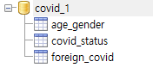
DataBase 설계(테이블)
age_gender: 연령별, 성별 코로나 현황
covid_status: 광역시도별 코로나 현황
foreign_covid: 코로나 해외 현황

Slide 3
DataBase 설계(age_gender)
date | text | not null | 집계 날짜
target | text | not null | 연령/성
confCase | int |  | 확진자 수
confRate | float |  | 확진자 비중(%)
criRate | float |  | 치명률(%)
death | int |  | 사망자 수
deathrate | float |  | 사망자 비중(%)

Slide 4
DataBase 설계(covid_status)
date | text | not null | 집계 날짜
region | text | not null | 광역시도
def_cnts | int |  | 확진자 수
local_occ | int |  | 국내발생 수
over_flow | int |  | 해외유입 수
inc_decs | int |  | 전일 대비 확진자
death_cnts | int |  | 사망자
isol_clr | int |  | 격리 해제
isol_ing | int |  | 격리 중
qur_rates | float |  | 10만명 당 발생률

Slide 5
DataBase 설계(foreign_covid)
date | text | not null | 집계 날짜
continent | text | not null | 지역(대륙)
nation | text | not null | 국가
natDef | int |  | 확진자 수
natDeath | int |  | 사망자 수
natDeathRate | float |  | 확진률 대비 사망률

Slide 6
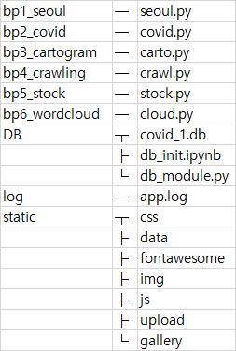
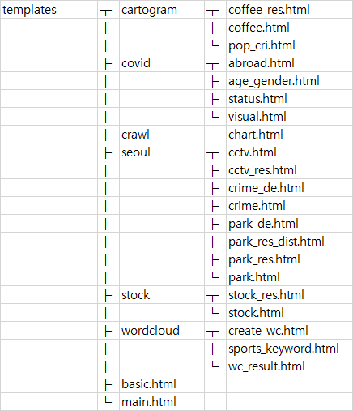
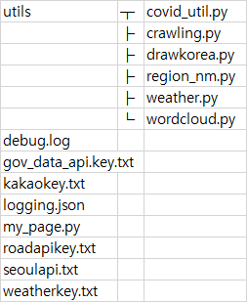
파일 구조 – 데이터 분석

Slide 7
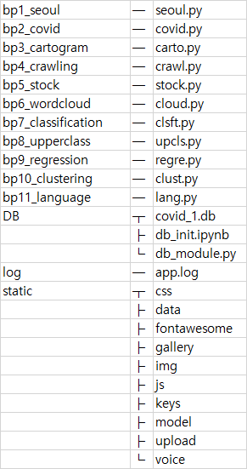
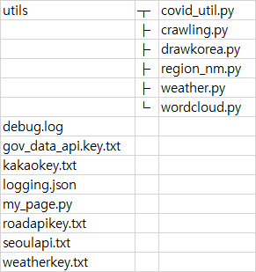
파일 구조 – 머신러닝

Slide 8
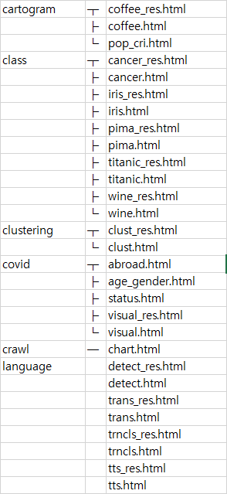
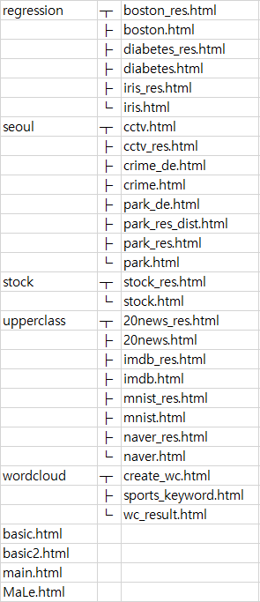
파일 구조 – 머신러닝(templates)

Slide 9
Routing - 메인
path | detail path | method | client -> server parameter | html파일 | server -> html params | 다음 행선지
/ |  | get |  |  |  | /main, /MaLe
/main |  | get |  | main.html | menu, weather | /seoul, /covid, /crawl, /stock, /carto, /cloud
/MaLe |  | get |  | MaLe.html | menu, weather | /class, /upcls, /regre, /clust,

Slide 10
Routing - /seoul
path | detail path | method | client -> server parameter | html파일 | server -> html params | 다음 행선지
/seoul |  |  |  |  |  | /seoul/park /seoul/park_de/area /seoul/crime /seoul/cctv
/seoul/park |  | get |  | park.html | menu, weather, park_list, dist_list, mtime | park_res.html park_res_dist.html
 |  | post | distinct, name/dist | park_res.html park_res_dist.html | menu, weather, park_result/ dist_result, mtime
/seoul/park_de | /area | get | option | park_de.html | menu, weather, option, option_dict, mtime
 | /count
 | /area_ratio
 | /per_person

Slide 11
Routing - /seoul
path | detail path | method | client -> server parameter | html파일 | server -> html params | 다음 행선지
/seoul/crime |  |  |  |  |  | /crime_de/violence, /crime_de/rape, /crime_de/theft, /crime_de/robbery, /crime_de/murder, /crime_de/violence_arr, /crime_de/rape_arr, /crime_de/theft_arr, /crime_de/robbery_arr, /crime_de/murder_arr
/seoul/crime_de | /violence | get | option | crime_de.html | menu, weather, option, option_dict1, option_dict2, column_index, mtime
 | /rape
 | /theft
 | /robbery
 | /murder
 | /violence_arr | post
 | /rape_arr
 | /theft_arr
 | /robbery_arr
 | /murder_arr

Slide 12
Routing - /seoul
path | detail path | method | client -> server parameter | html파일 | server -> html params | 다음 행선지
/seoul/cctv |  | get |  | cctv.html |  | cctv_res.html
 |  | post | kind | cctv_res.html | kind, menu, weather, mtime

Slide 13
Routing - /covid
path | detail path | method | client -> server parameter | html파일 | server -> html params | 다음 행선지
/covid |  |  |  |  |  | /covid/national_status, /covid/age_gender, /covid/abroad, /covid/visual
/covid/national_status |  | get |  | status.html | menu, weather, rows, date | /covid/update_status
/covid/update_status | <date> | get | date
/covid/age_gender |  | get |  | age_gender.html | menu, weather, rows, date | /covid/update_age_gender
/covid/update_age_gender | <date> | get | date
/covid/abroad |  | get |  | abroad.html | menu, weather, rows, date | /covid/update_abroad
/covid/update_abroad | <date> | get | date
/covid/visual |  | get |  | visual.html | menu, weather, mtime, regions | visual_res.html
 |  | post | district | visual_res.html | menu, weather, mtime

Slide 14
Routing - /carto
path | detail path | method | client -> server parameter | html파일 | server -> html params | 다음 행선지
/carto |  |  |  |  |  | /carto/pop_crisis, /carto/coffee
/carto/pop_crisis | /crisis_area | get | option | pop_cri.html | menu, weather, mtime, option, columns
 | /crisis_ratio
/carto/coffee |  | get |  | coffee.html | menu, weather | coffee_res.html
/covid/update_age_g | <date> | post | carto_list, csv | coffee_res.html | menu, weather, carto, mtime, top10

Slide 15
Routing - /crawl
path | detail path | method | client -> server parameter | html파일 | server -> html params | 다음 행선지
/crawl |  |  |  |  |  | /crawl/chart
/crawl/chart |  | get |  | chart.html | menu, weather, bugs, melon, genie

Slide 16
Routing - /cloud
path | detail path | method | client -> server parameter | html파일 | server -> html params | 다음 행선지
/cloud |  |  |  |  |  | /cloud/create_wc, /cloud/sports_keyword
/cloud/create_wc |  | get |  | create_wc.html | menu, weather | wc_result.html
 | /crisis_ratio | post | lang, txt, mask, stopwords | wc_result.html | menu, weather, mtime
/cloud/sports_keyword |  | get |  | sports_keyword.html | menu, weather, mtime

Slide 17
Routing - /class
path | detail path | method | client -> server parameter | html파일 | server -> html params | 다음 행선지
/class |  |  |  |  |  | /class/cancer
/class/cancer |  | get |  | cancer.html | menu, weather | cancer_res.html
/covid/update_age_g | <date> | post | index | cancer_res.html | menu, weather, result
/class/pima |  | get |  | pima.html | menu, weather | pima_res.html
 |  | post | index | pima_res.html | menu, weather, dict
/class/titanic |  | get |  | titanic.html | menu, weather | titanic_res.html
 |  | post | index | titanic_res.html | menu, weather, dict
/class/iris |  | get |  | iris.html | menu, weather | iris_res.html
 |  | post | index | iris_res.html | menu, weather, dict
/class/wine |  | get |  | wine.html | menu, weather | wine_res.html
 |  | post | index | wine_res.html | menu, weather, dict

Slide 18
Routing - /upcls
path | detail path | method | client -> server parameter | html파일 | server -> html params | 다음 행선지
/upcls |  |  |  |  |  | /upcls/mnist
/upcls/mnist |  | get |  | mnist.html | menu, weather | mnist_res.html
/covid/update_age_g | <date> | post | index | mnist_res.html | menu, weather, dict, mtime
/upcls/20news |  | get |  | 20news.html | menu, weather | 20news_res.html
 |  | post | index | 20news_res.html | menu, weather, result
/upcls/IMDB |  | get |  | imdb.html | menu, weather | imdb_res.html
 |  | post | select, review, index | imdb_res.html | menu, weather, p_c, p_t, review
/upcls/NaverMovie |  | get |  | naver.html | menu, weather | naver_res.html
 |  | post | select, review, index | naver_res.html | menu, weather, result

Slide 19
Routing - /regre
path | detail path | method | client -> server parameter | html파일 | server -> html params | 다음 행선지
/regre |  |  |  |  |  | /regre/iris
/regre/iris |  | get |  | iris.html | menu, weather | iris_res.html
/covid/update_age_g | <date> | post | index, feature | iris_res.html | menu, weather, pred, index, X, feature, ft_name
/regre/diabetes |  | get |  | diabetes.html | menu, weather, list | diabete_res.html
 |  | post | index, feature | diabetes_res.html | menu, weather, pred, index, feature, list, label, mtime
/regre/boston |  | get |  | boston.html | menu, weather, columns | boston_res.html
 |  | post | index, feature | boston_res.html | menu, weather, dict

Slide 20
Routing - /clust
path | detail path | method | client -> server parameter | html파일 | server -> html params | 다음 행선지
/clust |  |  |  |  |  | /clust/clust
/clust/clust |  | get |  | clust.html | menu, weather | clust_res.html
/covid/update_age_g | <date> | post | file, n | clust_res.html | menu, weather, mtime, n_cluster

Slide 21
Routing - /lang
path | detail path | method | client -> server parameter | html파일 | server -> html params | 다음 행선지
/lang |  |  |  |  |  | /lang/translate
/lang/translate |  | get |  | trans.html | menu, weather | trans_res.html
/covid/update_age_g | <date> | post | text, lang | trans_res.html | menu, weather, result
/lang/tts |  | get |  | tts.html | menu, weather | tts_res.html
 |  | post | text, speaker, speed, pitch, emotion | tts_res.html | menu, weather, info, mtime
/lang/trn_cls |  | get |  | trncls.html | menu, weather | trncls_res.html
 |  | post | text, trans_type | trncls_res.html | menu, weather, result
/lang/detect_lang |  | get |  | detect.html | menu, weather | detect_res.html
 |  | post | text | detect_res.html | menu, weather, result

Slide 22
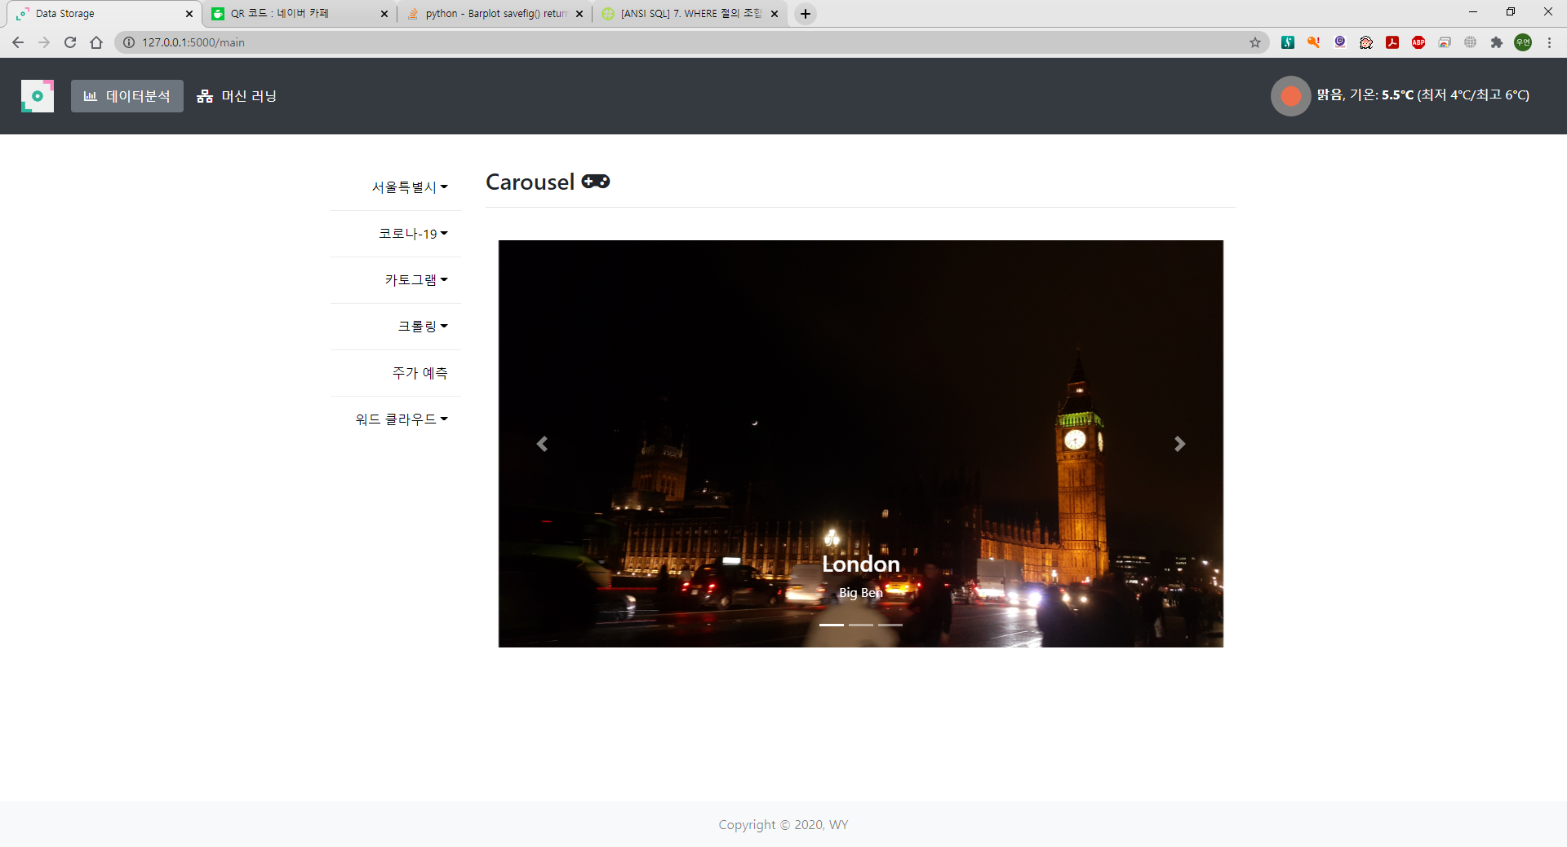
main 화면

Slide 23
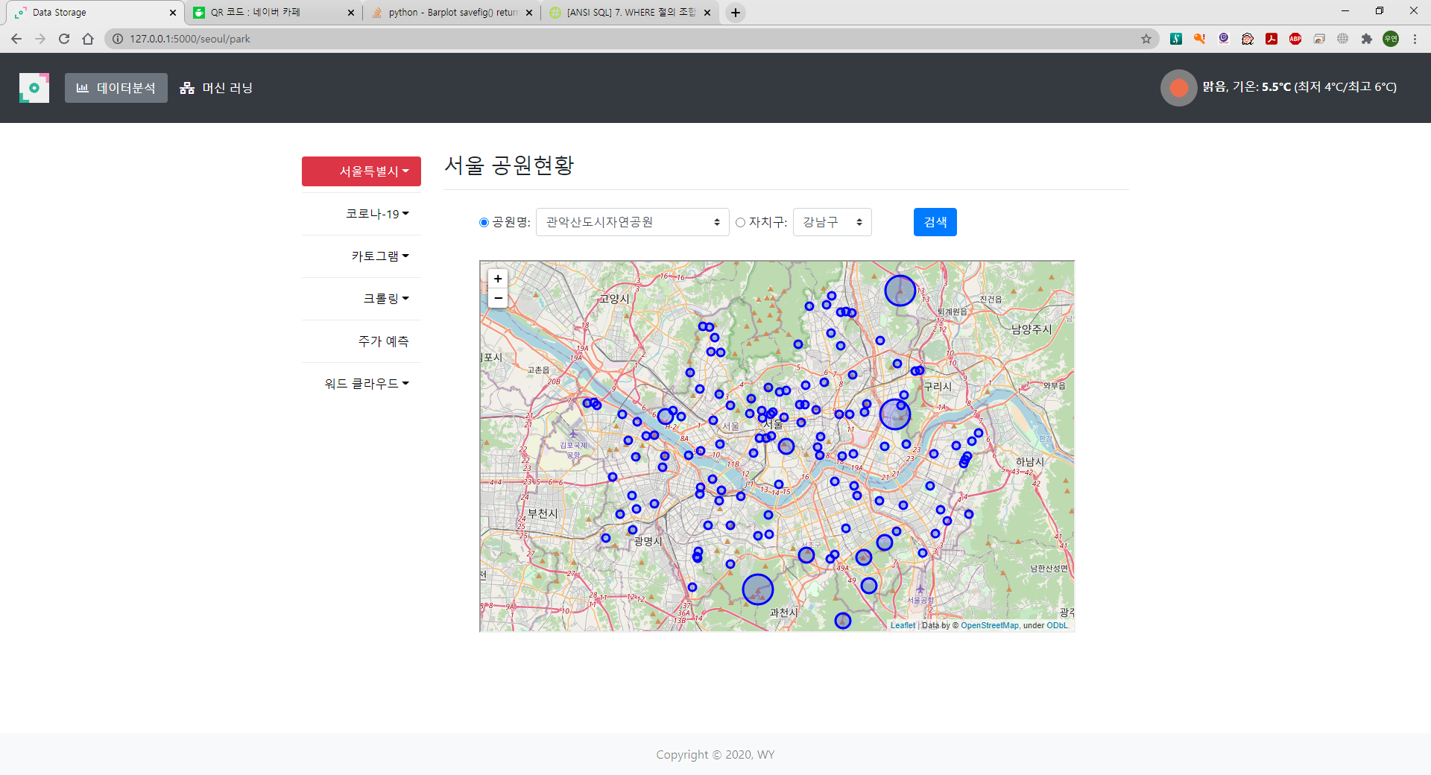
park.html

Slide 24
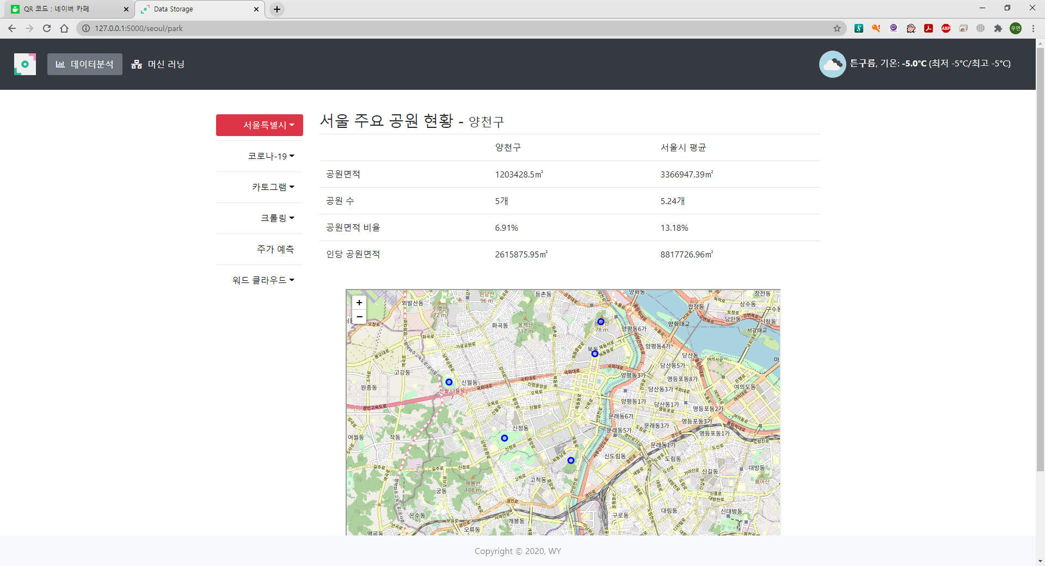
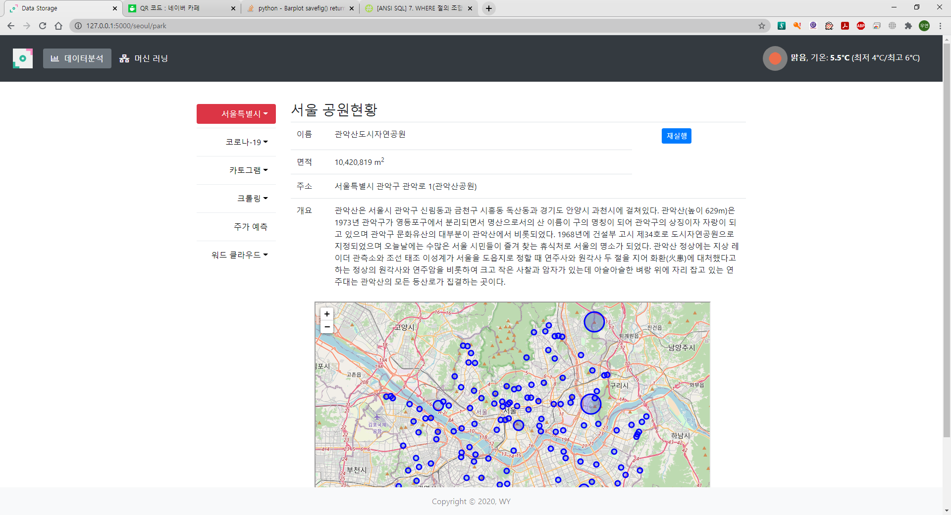
구 정보 입력 후
공원 정보 입력 후

Slide 25
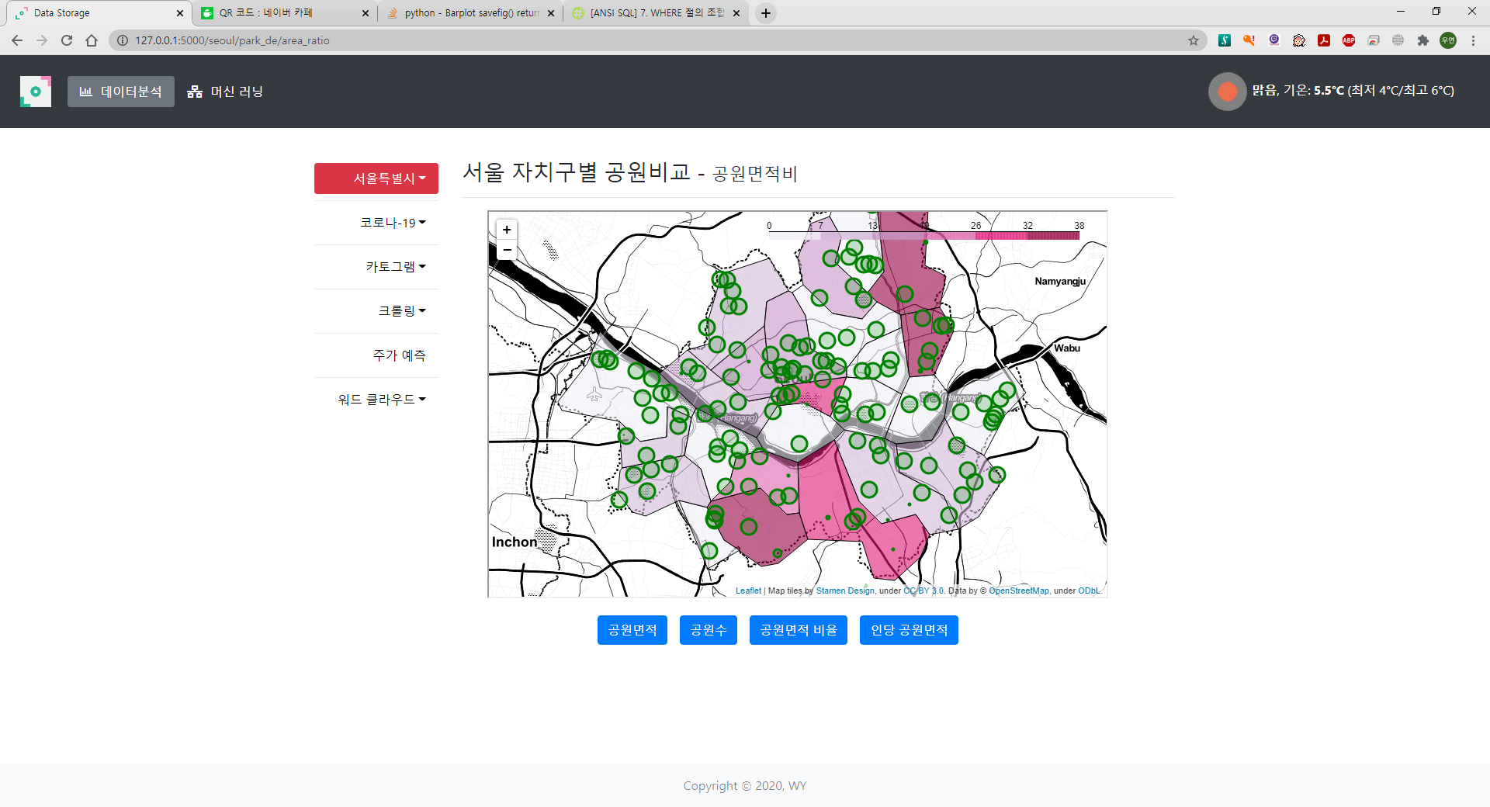
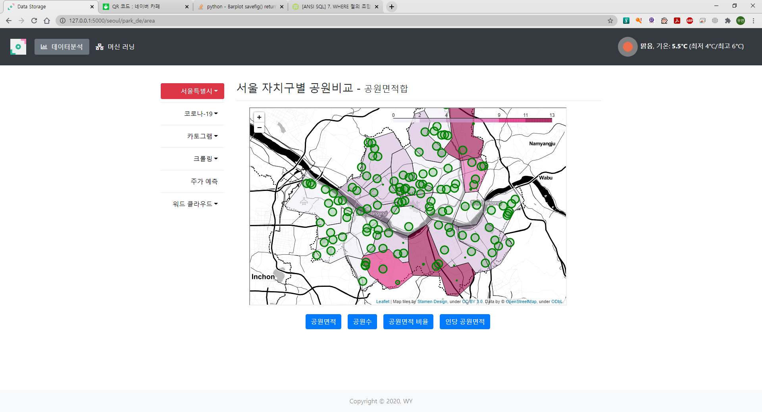
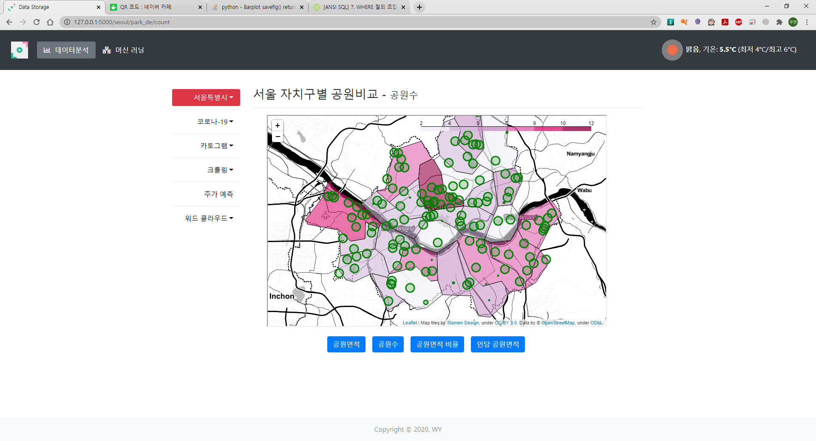
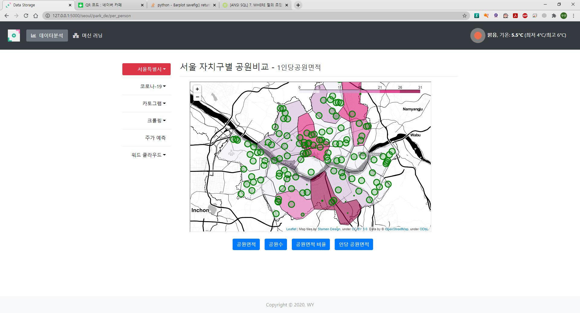

Slide 26
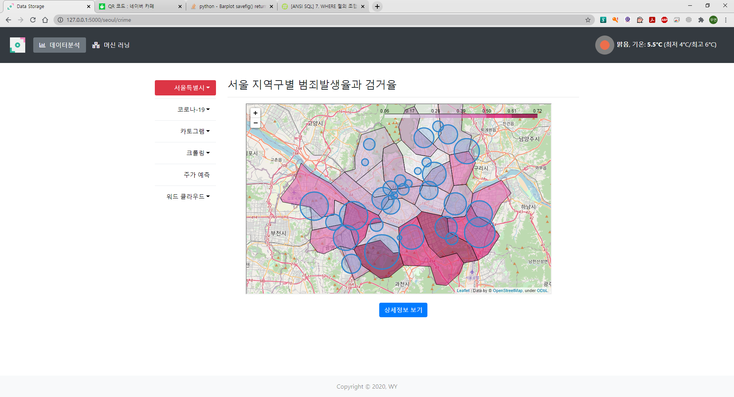

Slide 27
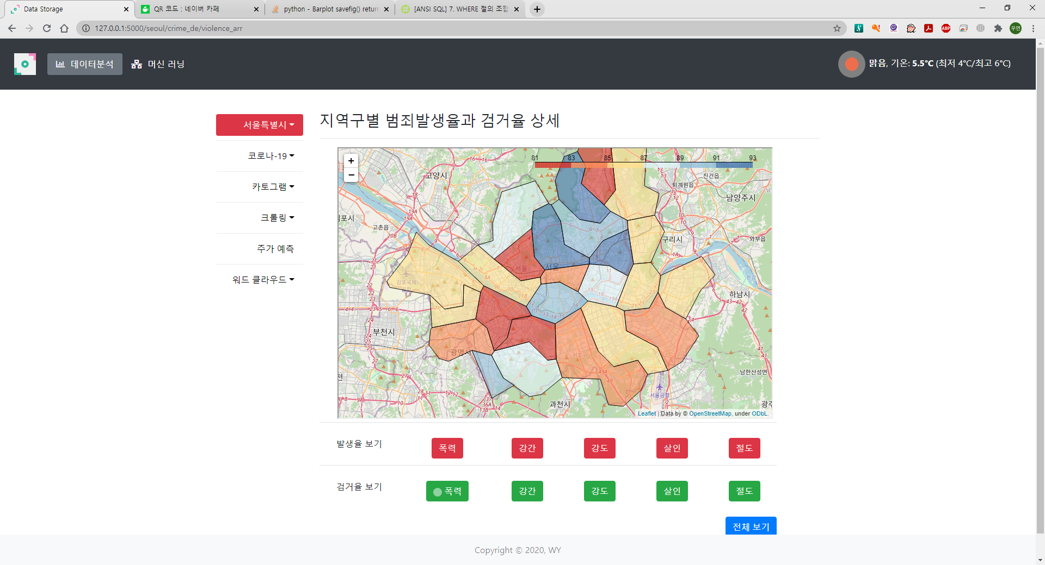
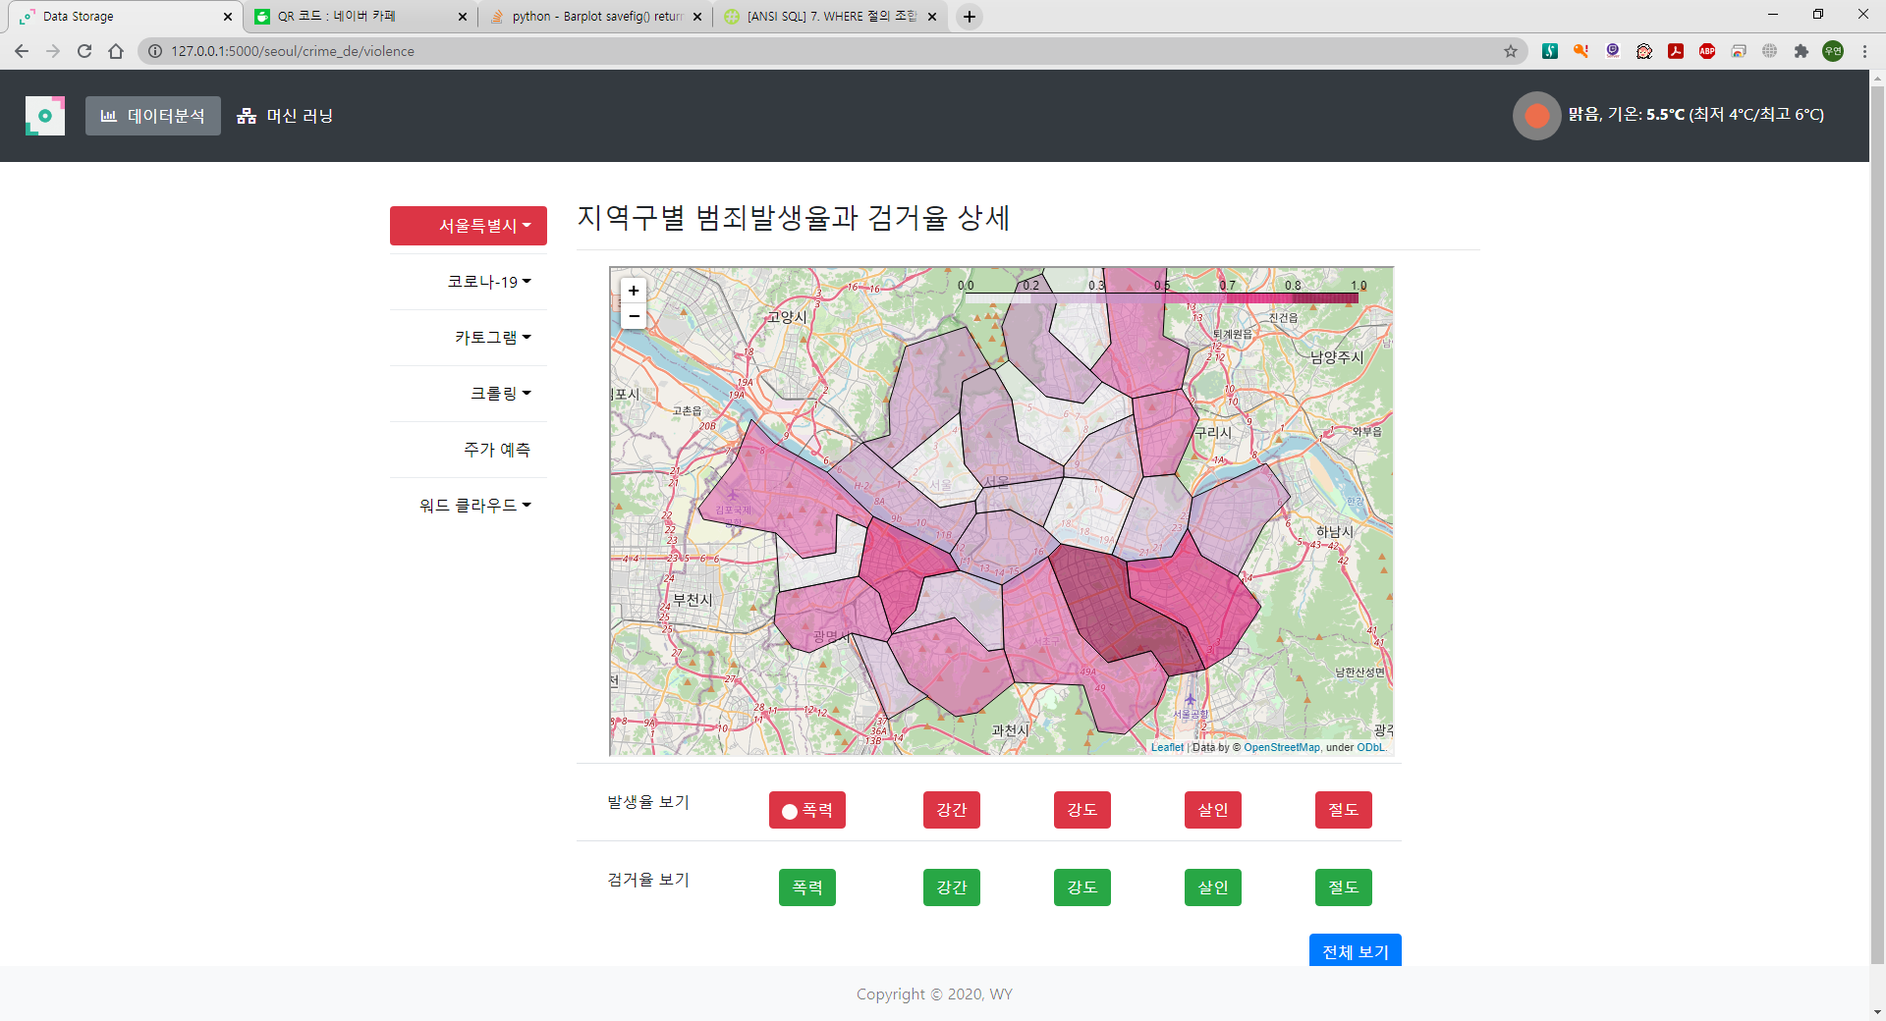
검거율 화면
상세 보기 클릭 후 – 발생률

Slide 28
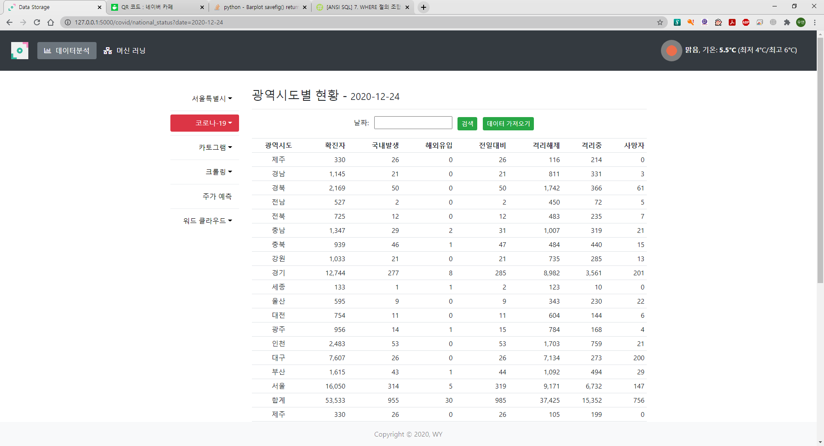

Slide 29
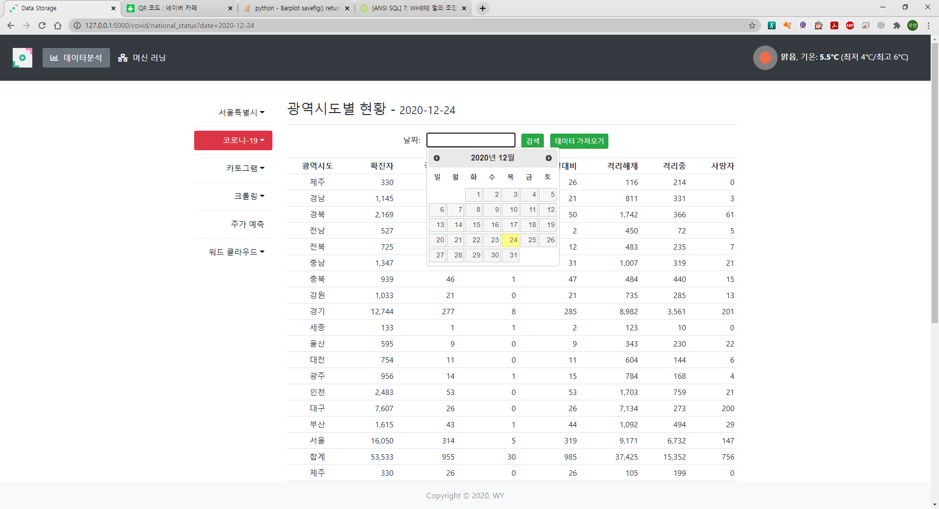
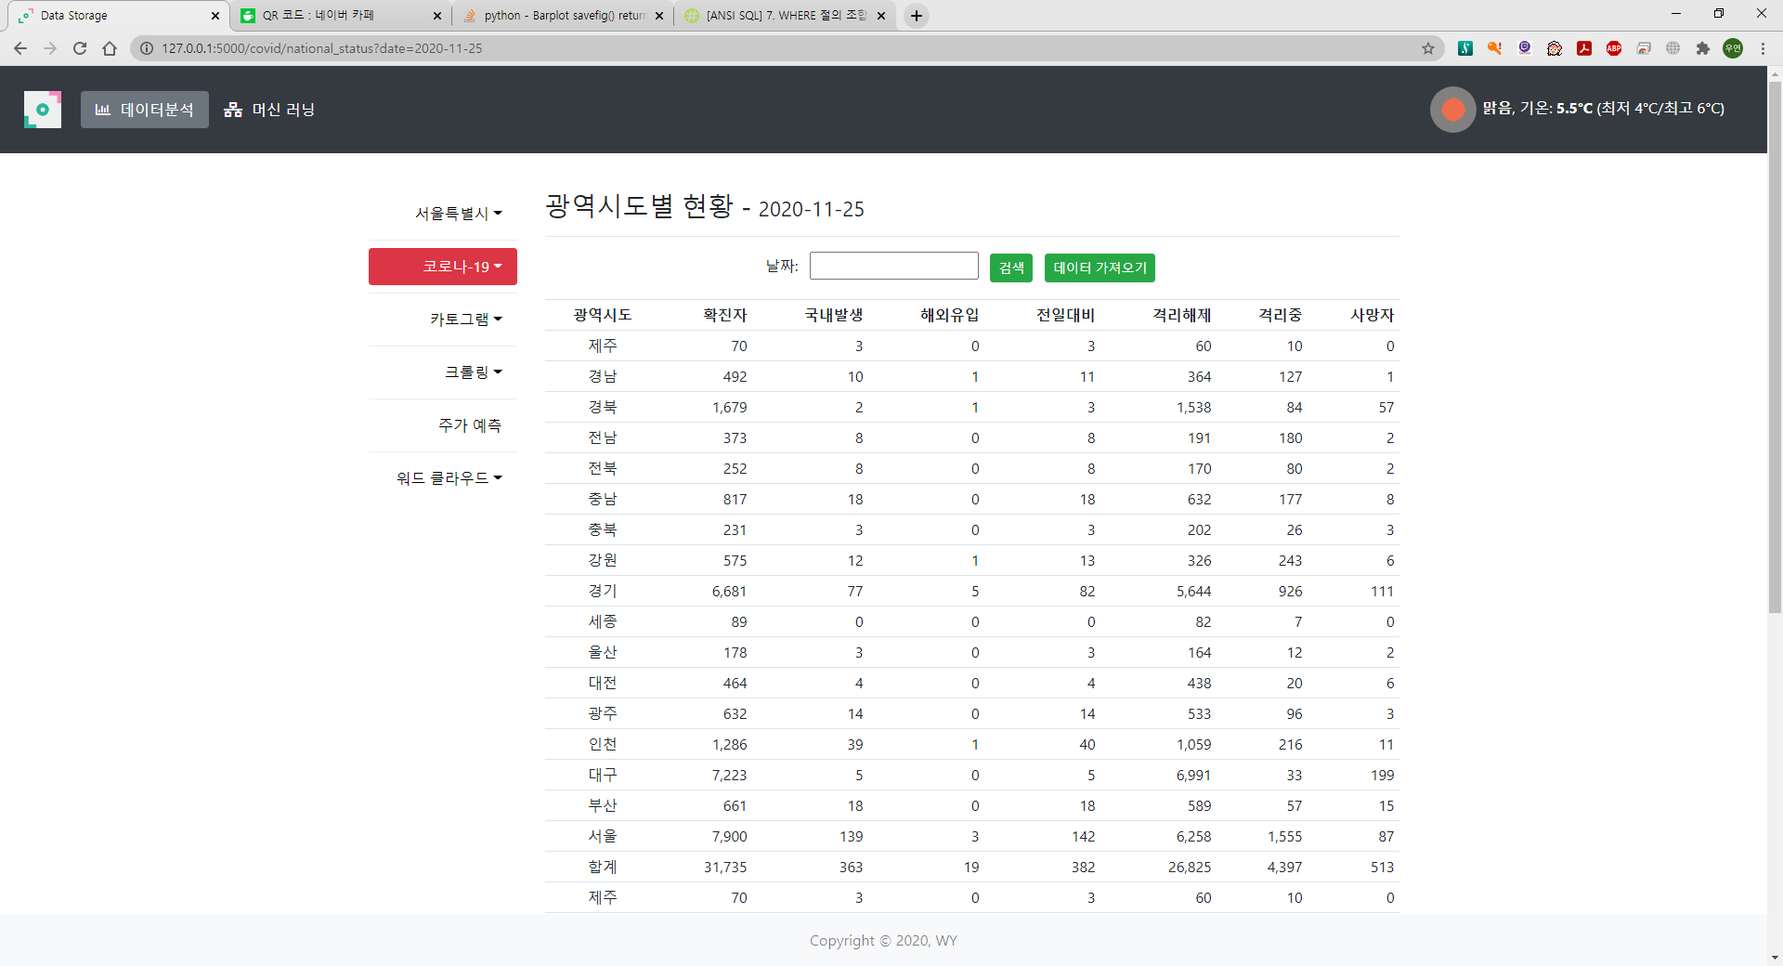
날짜 선택

Slide 30
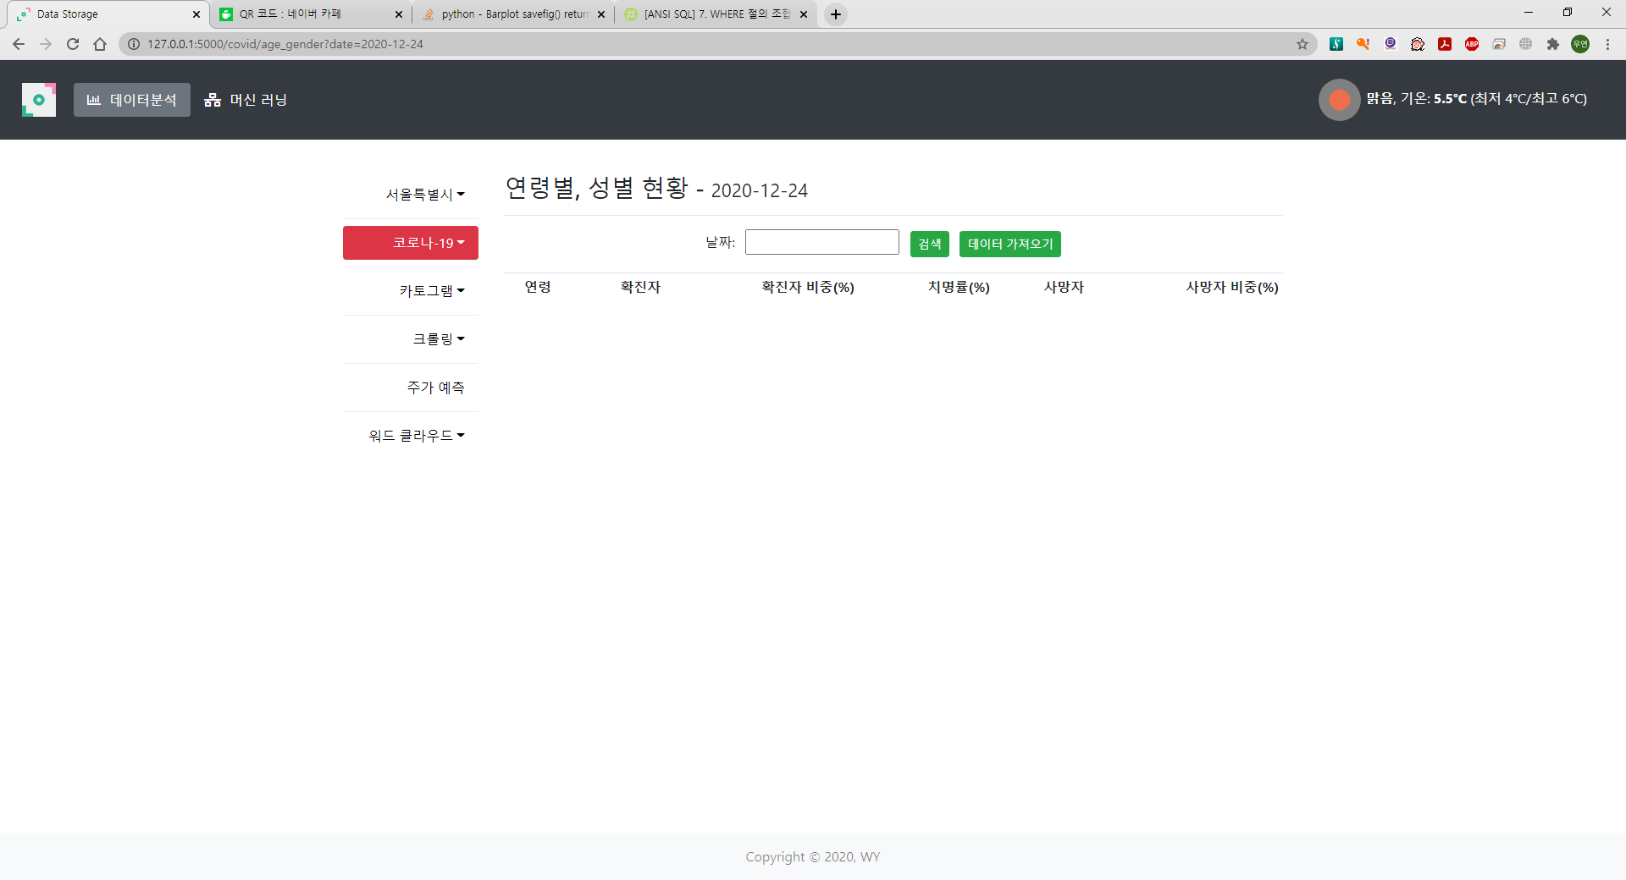

Slide 31
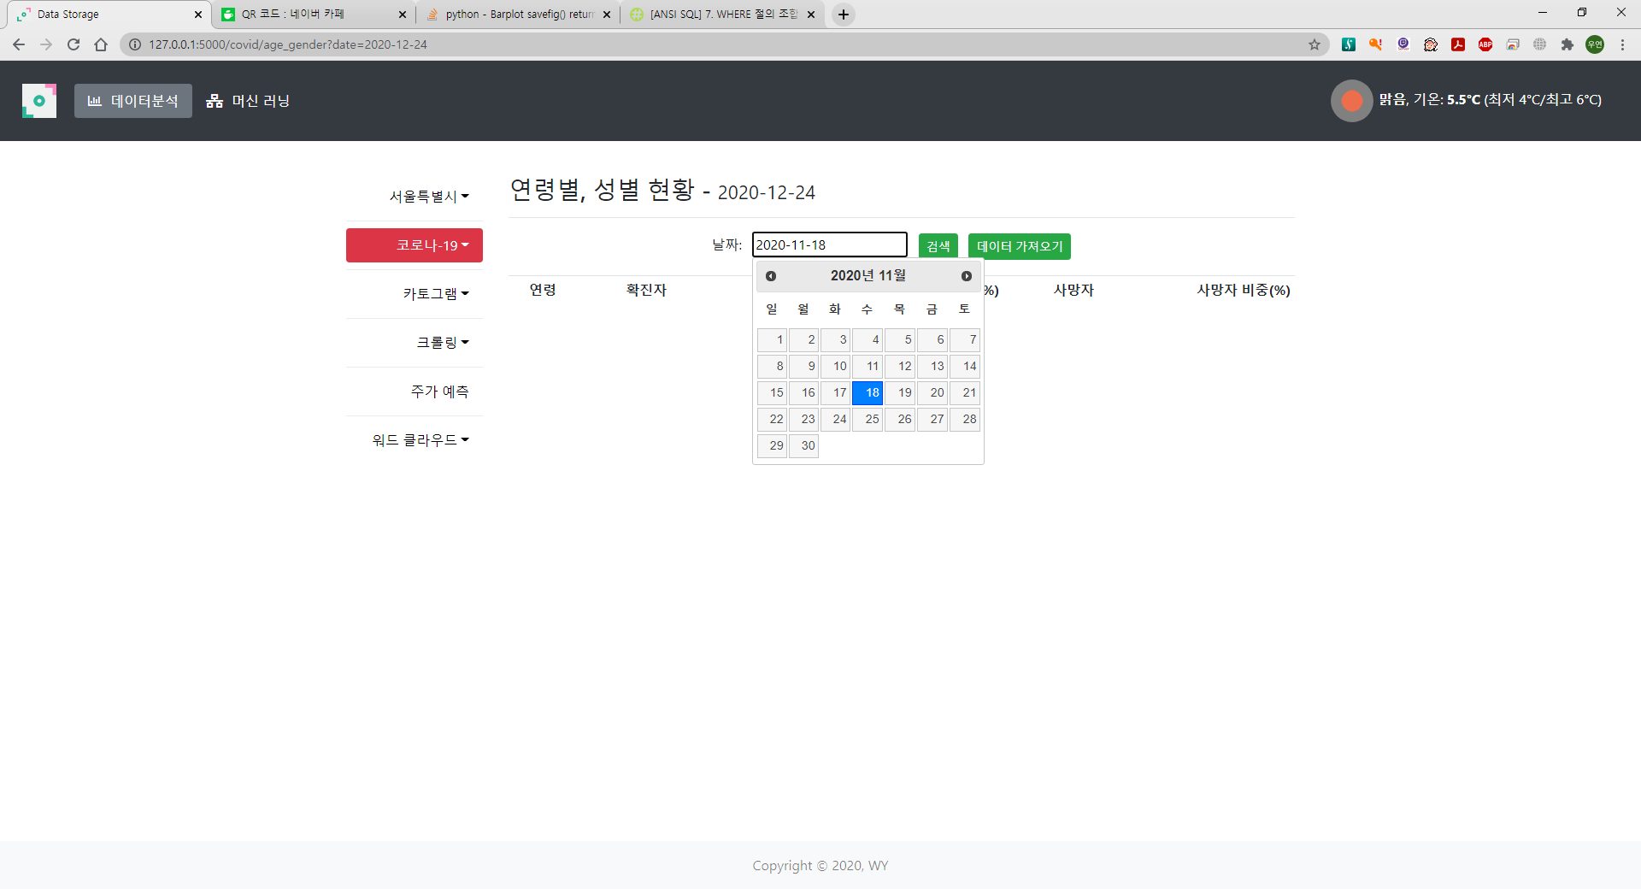
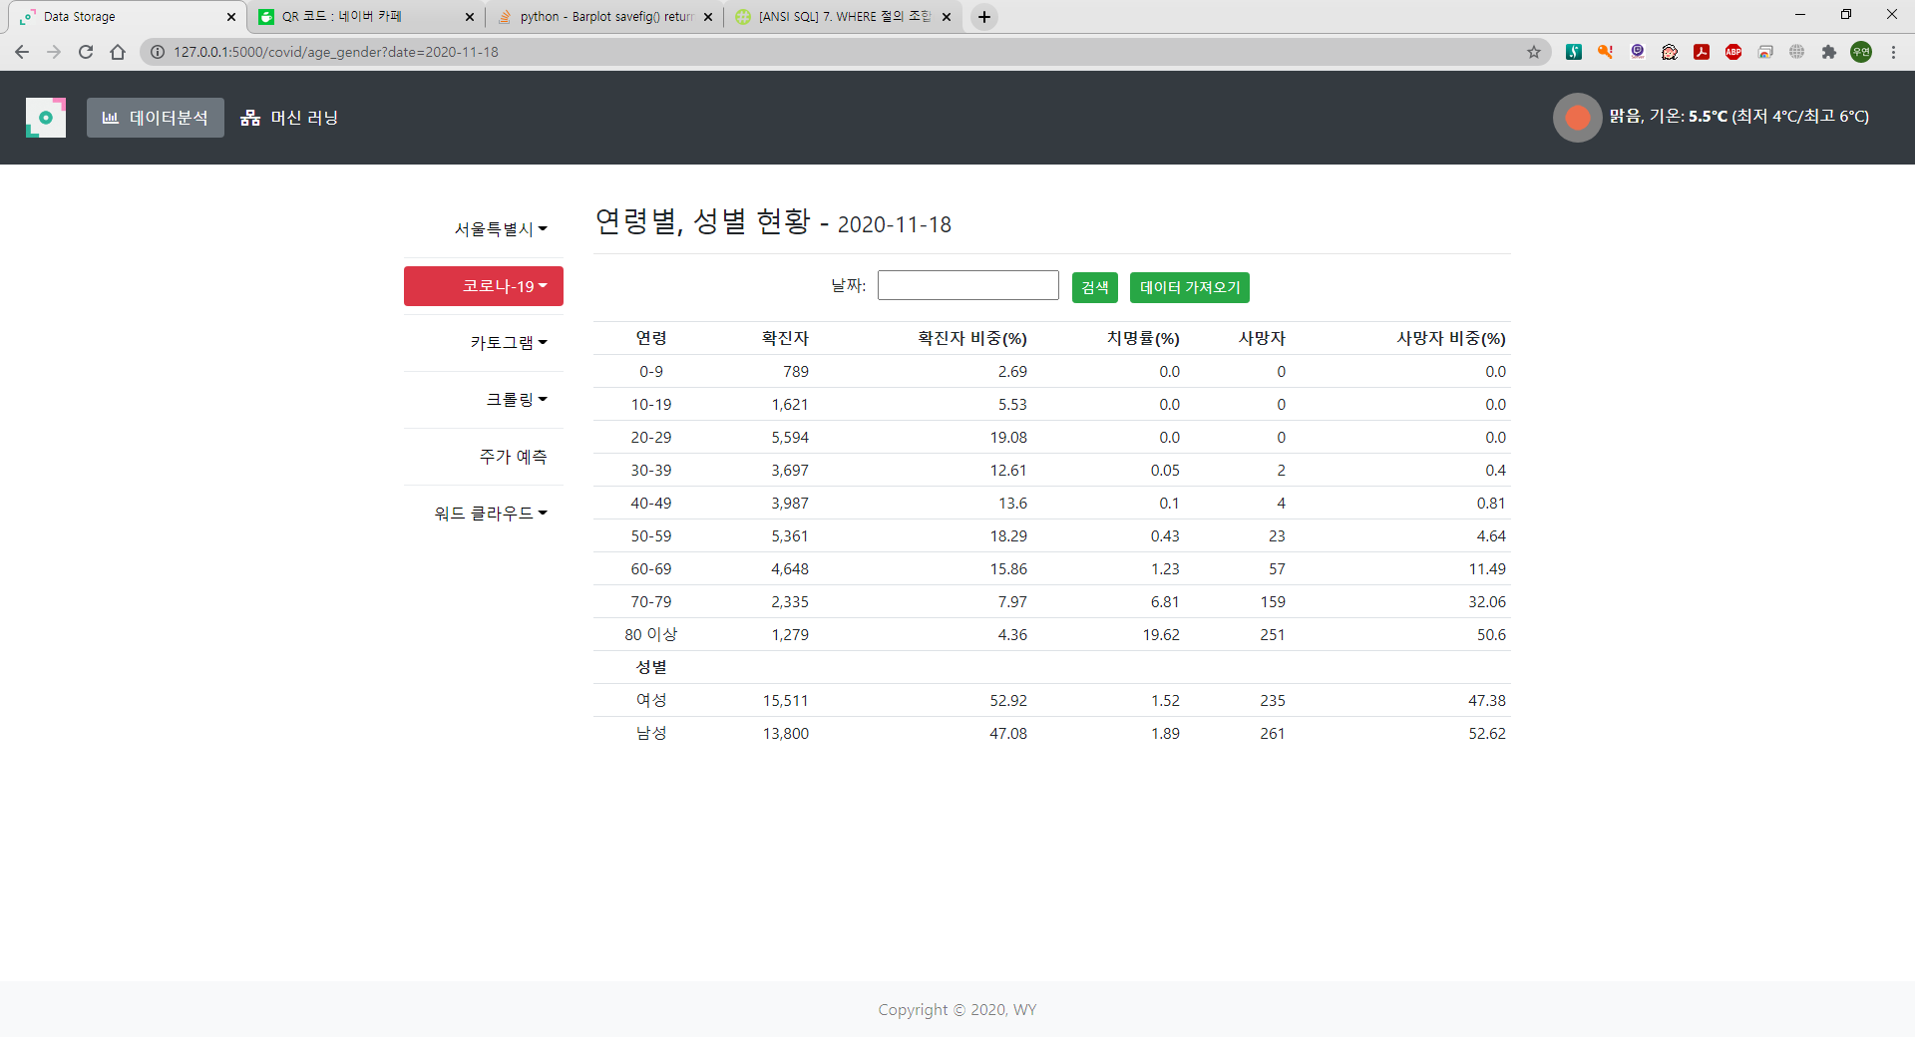
날짜 선택

Slide 32
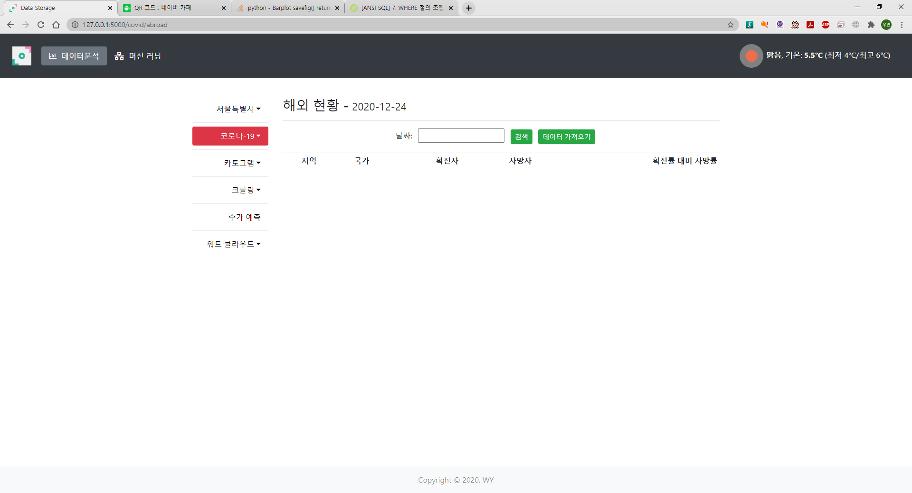

Slide 33
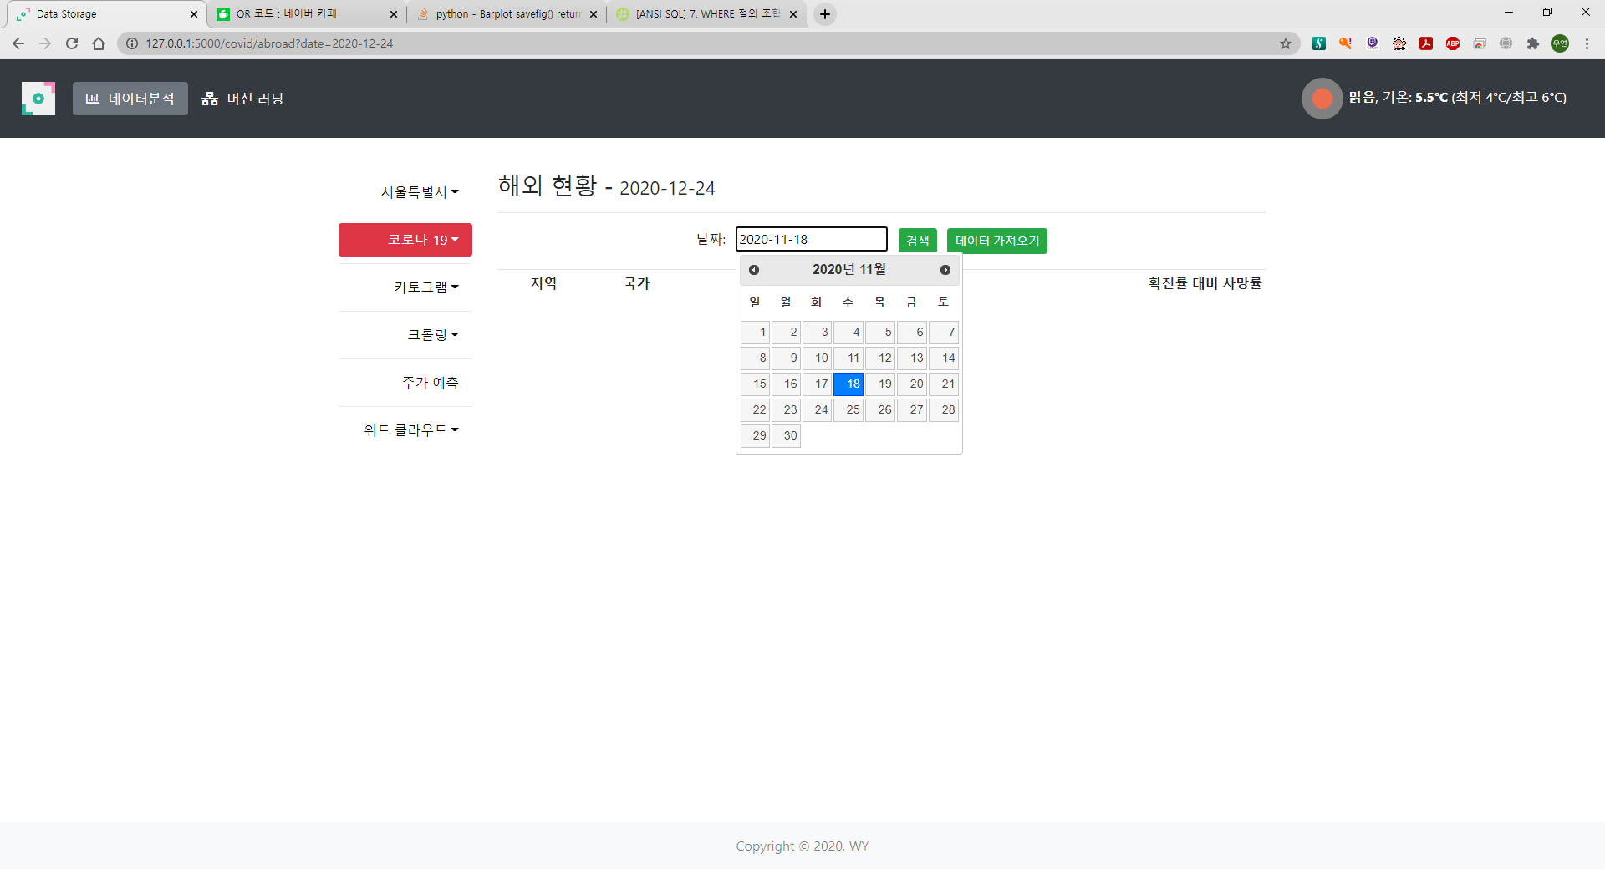
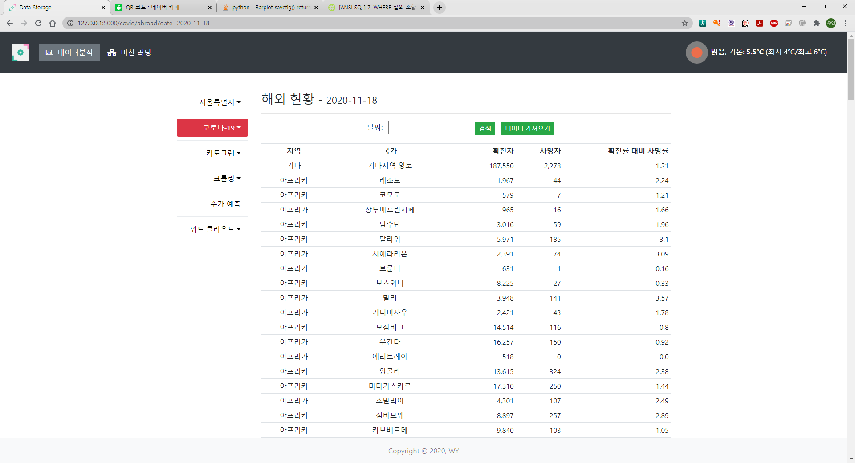
날짜 선택

Slide 34
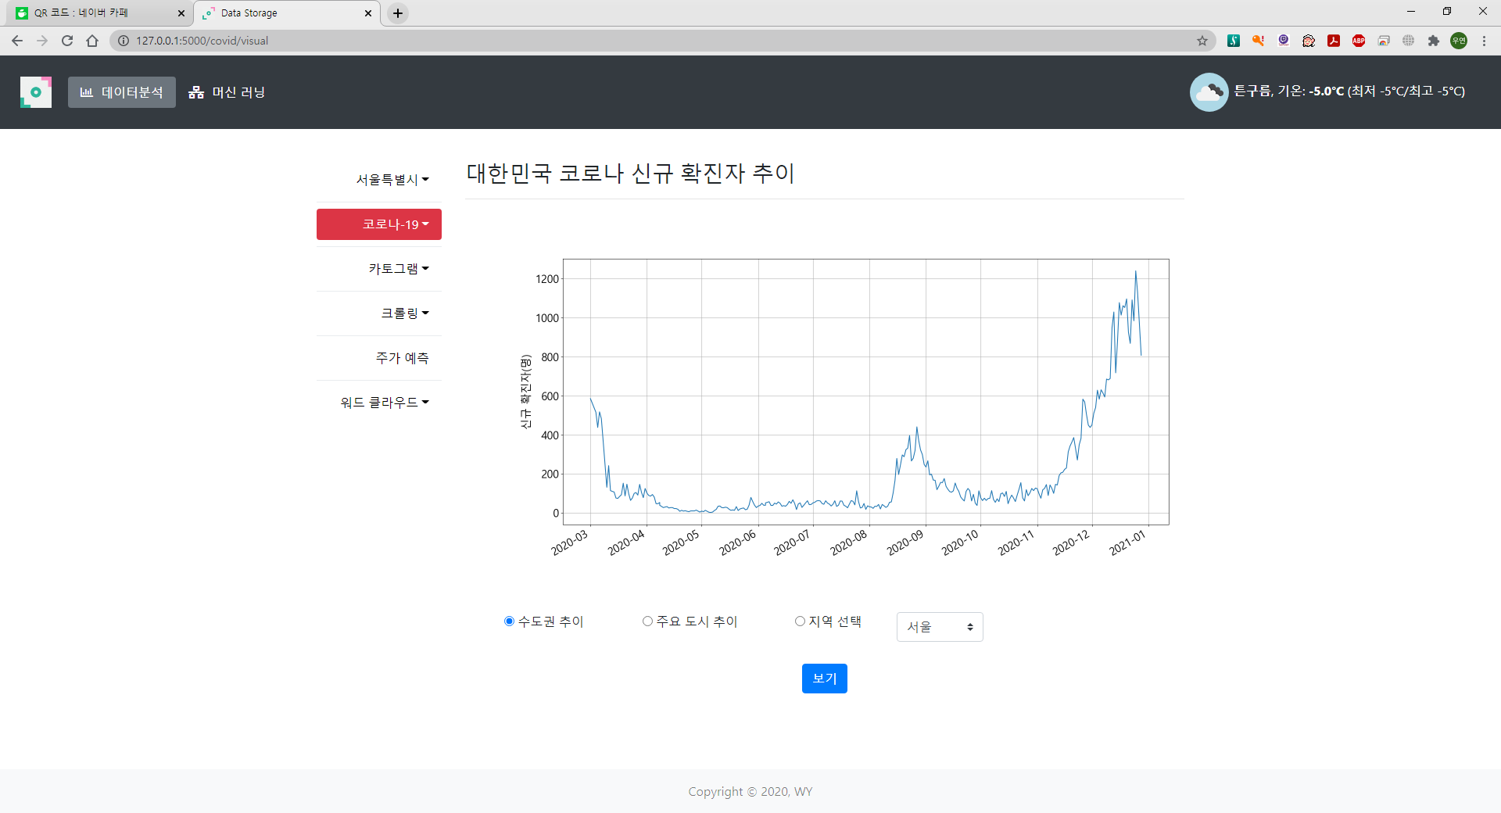

Slide 35
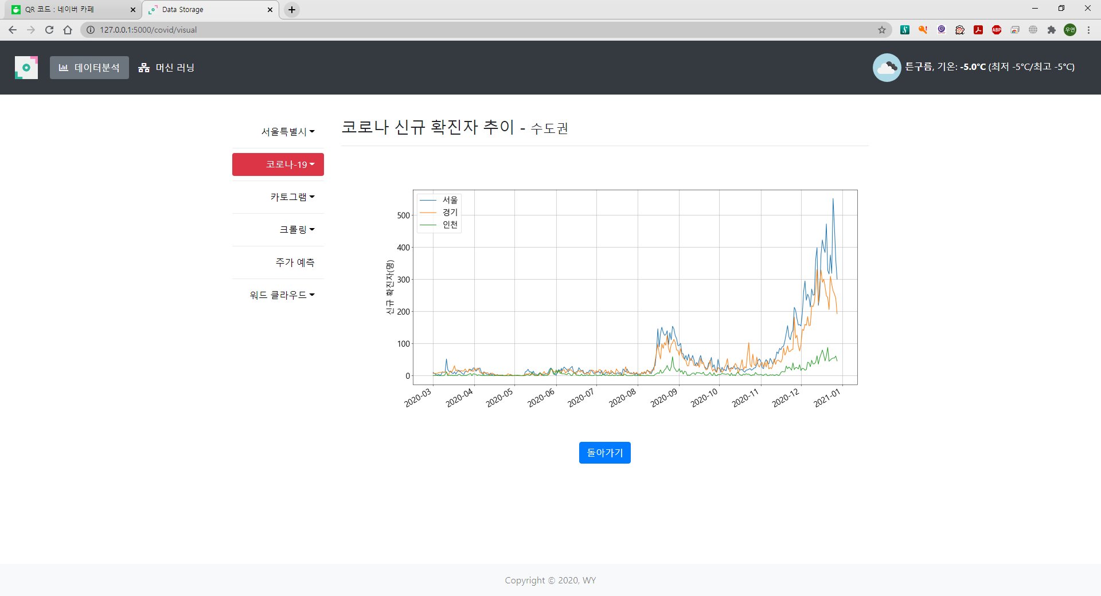
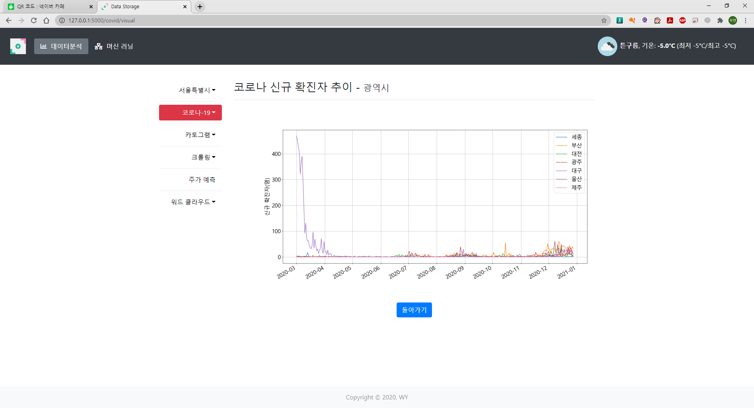
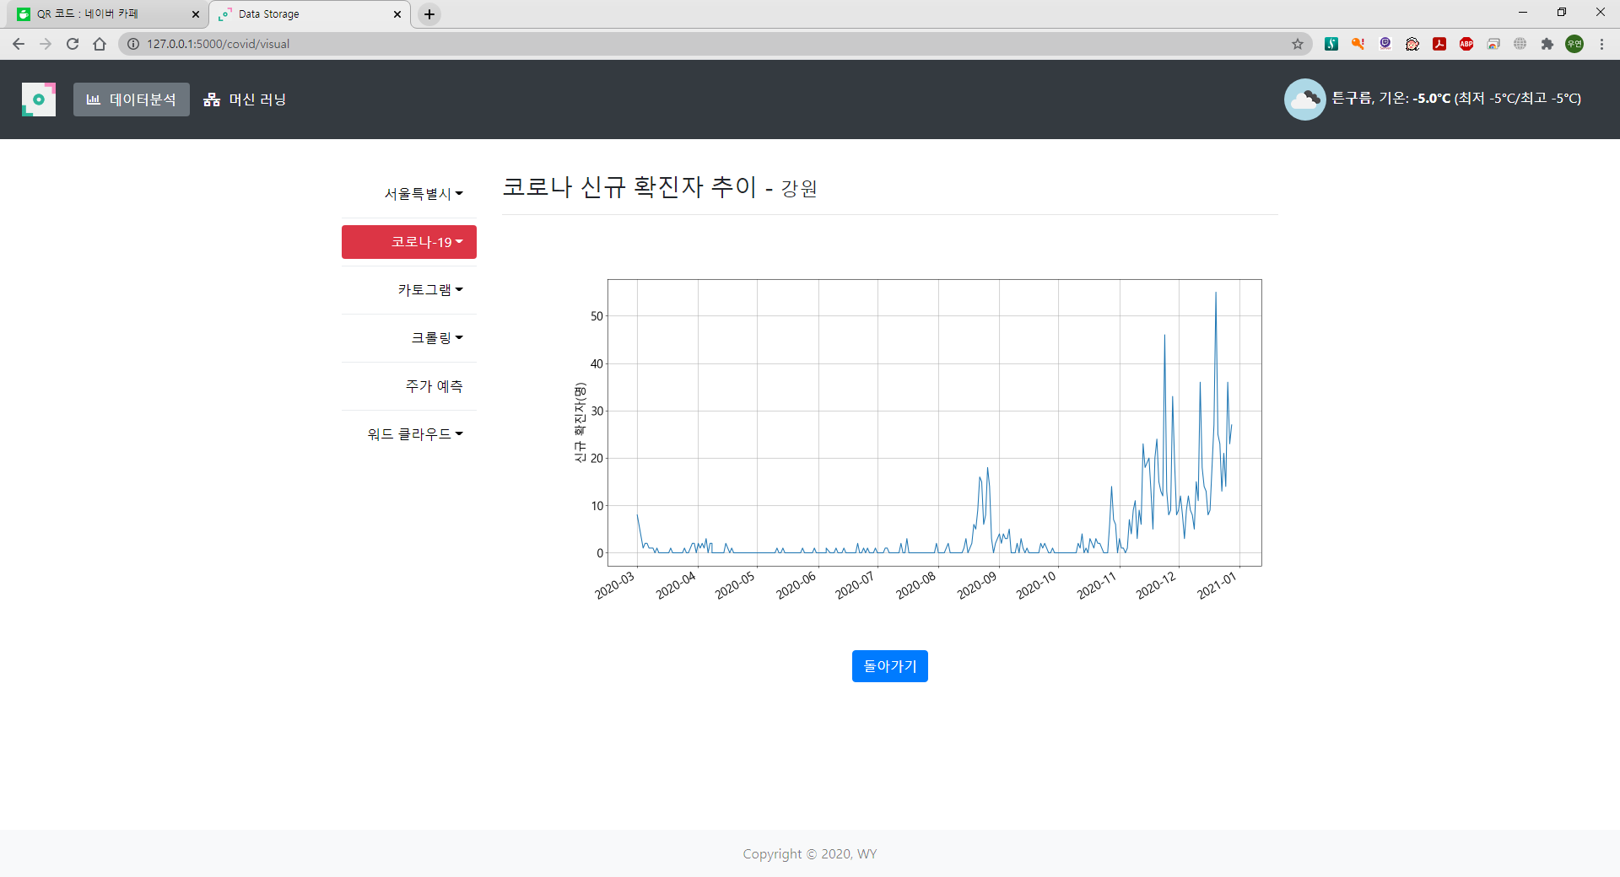
수도권 추이
주요 도시 추이
선택한 도시 추이

Slide 36
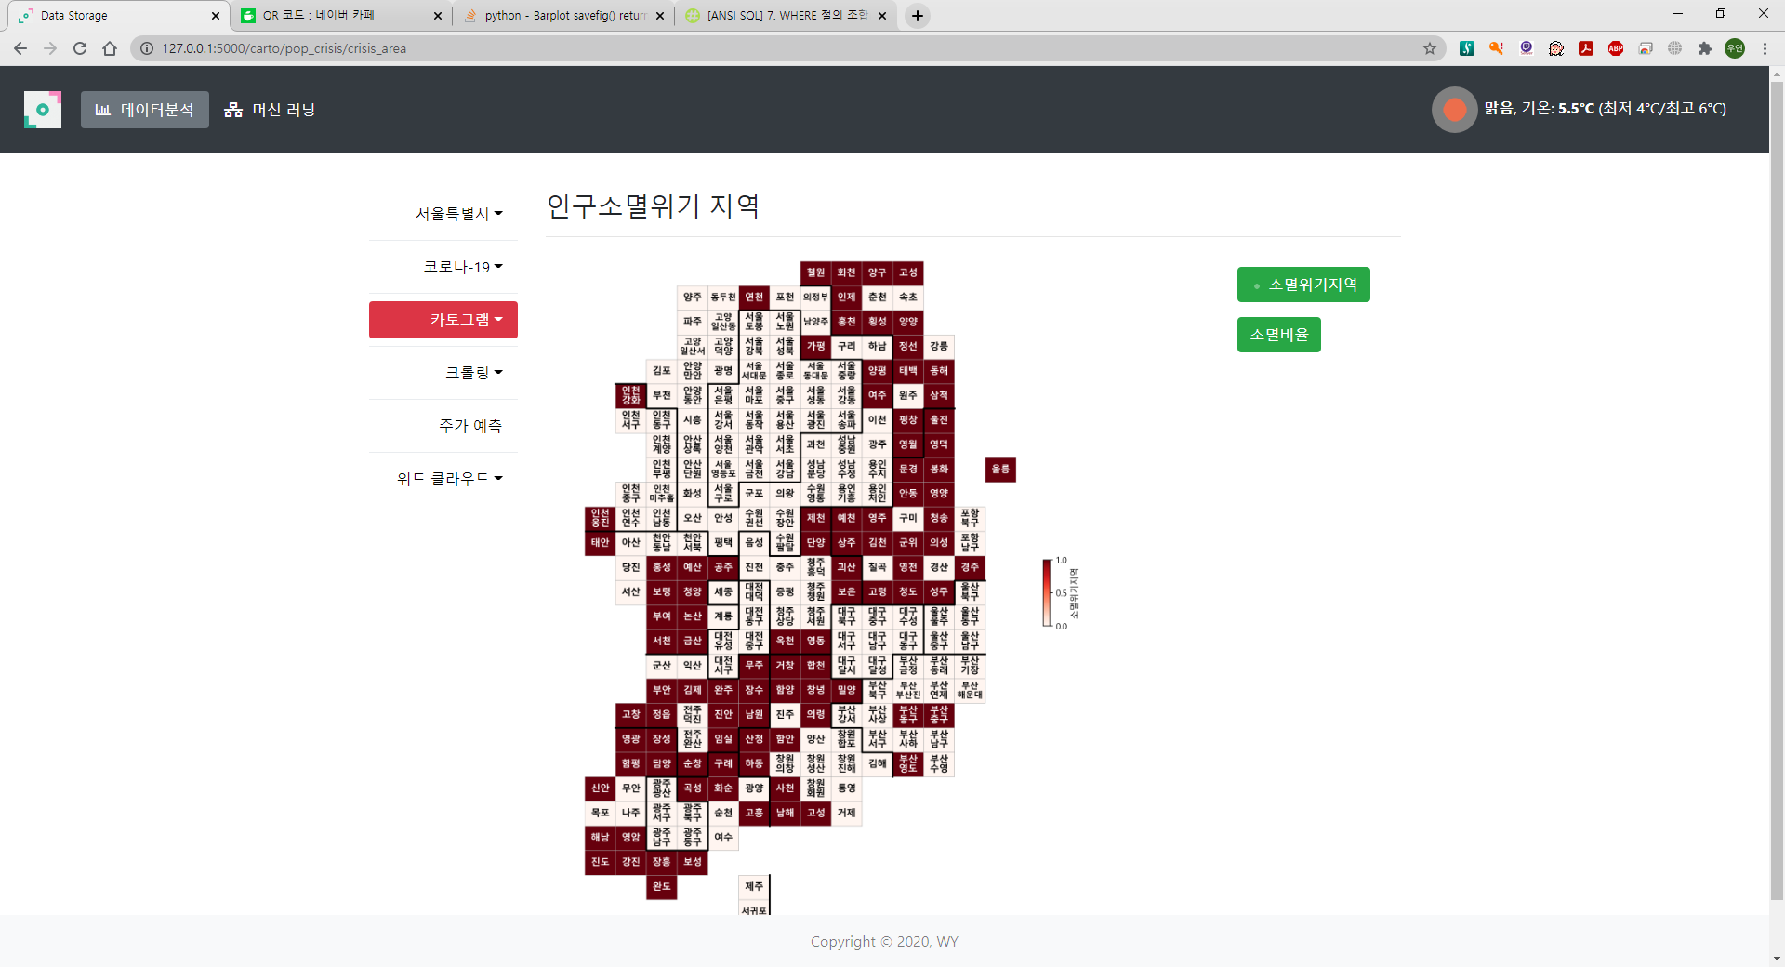

Slide 37
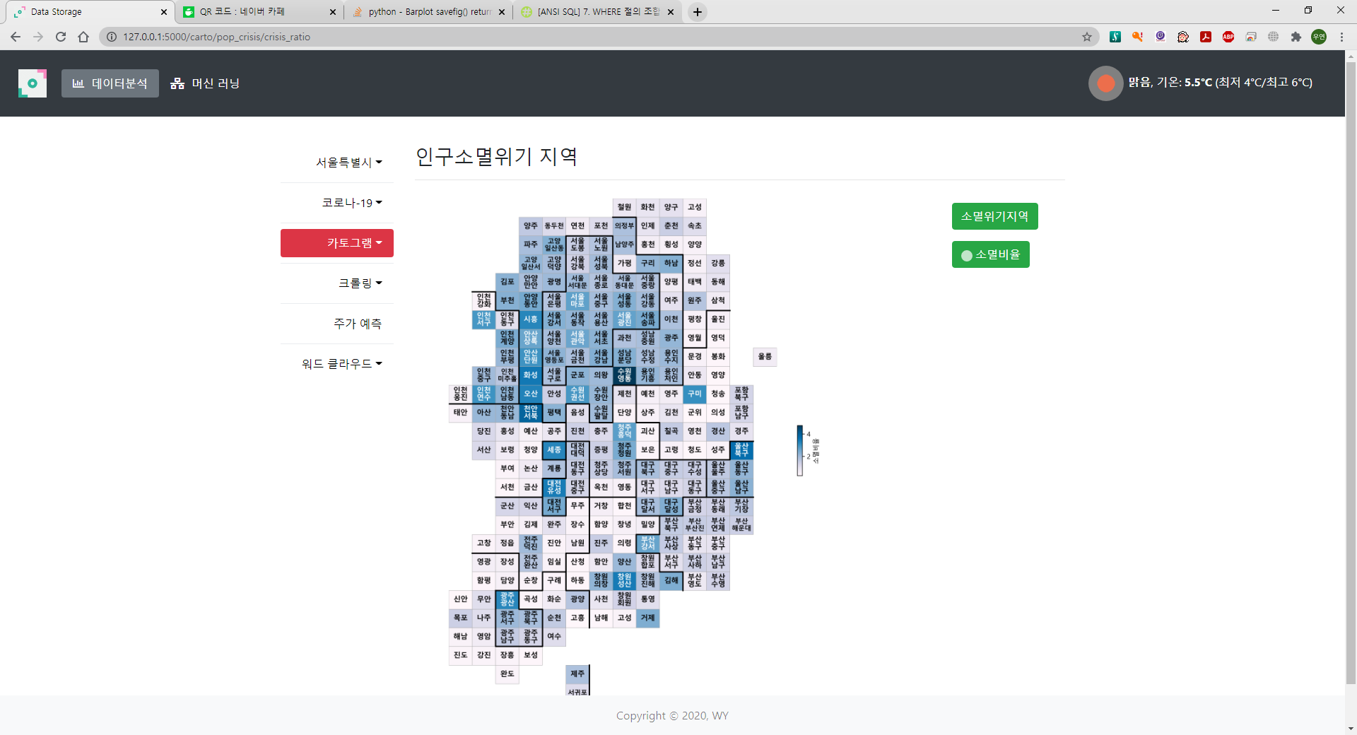

Slide 38
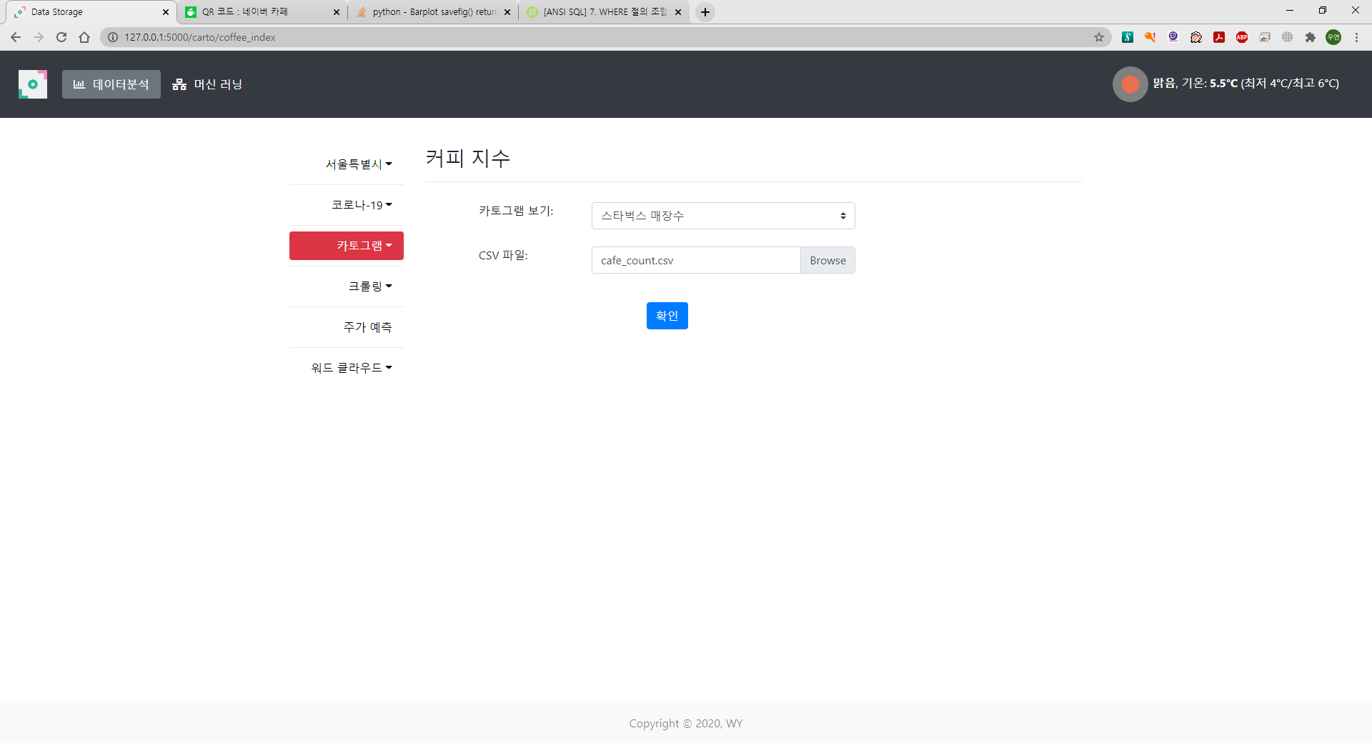

Slide 39
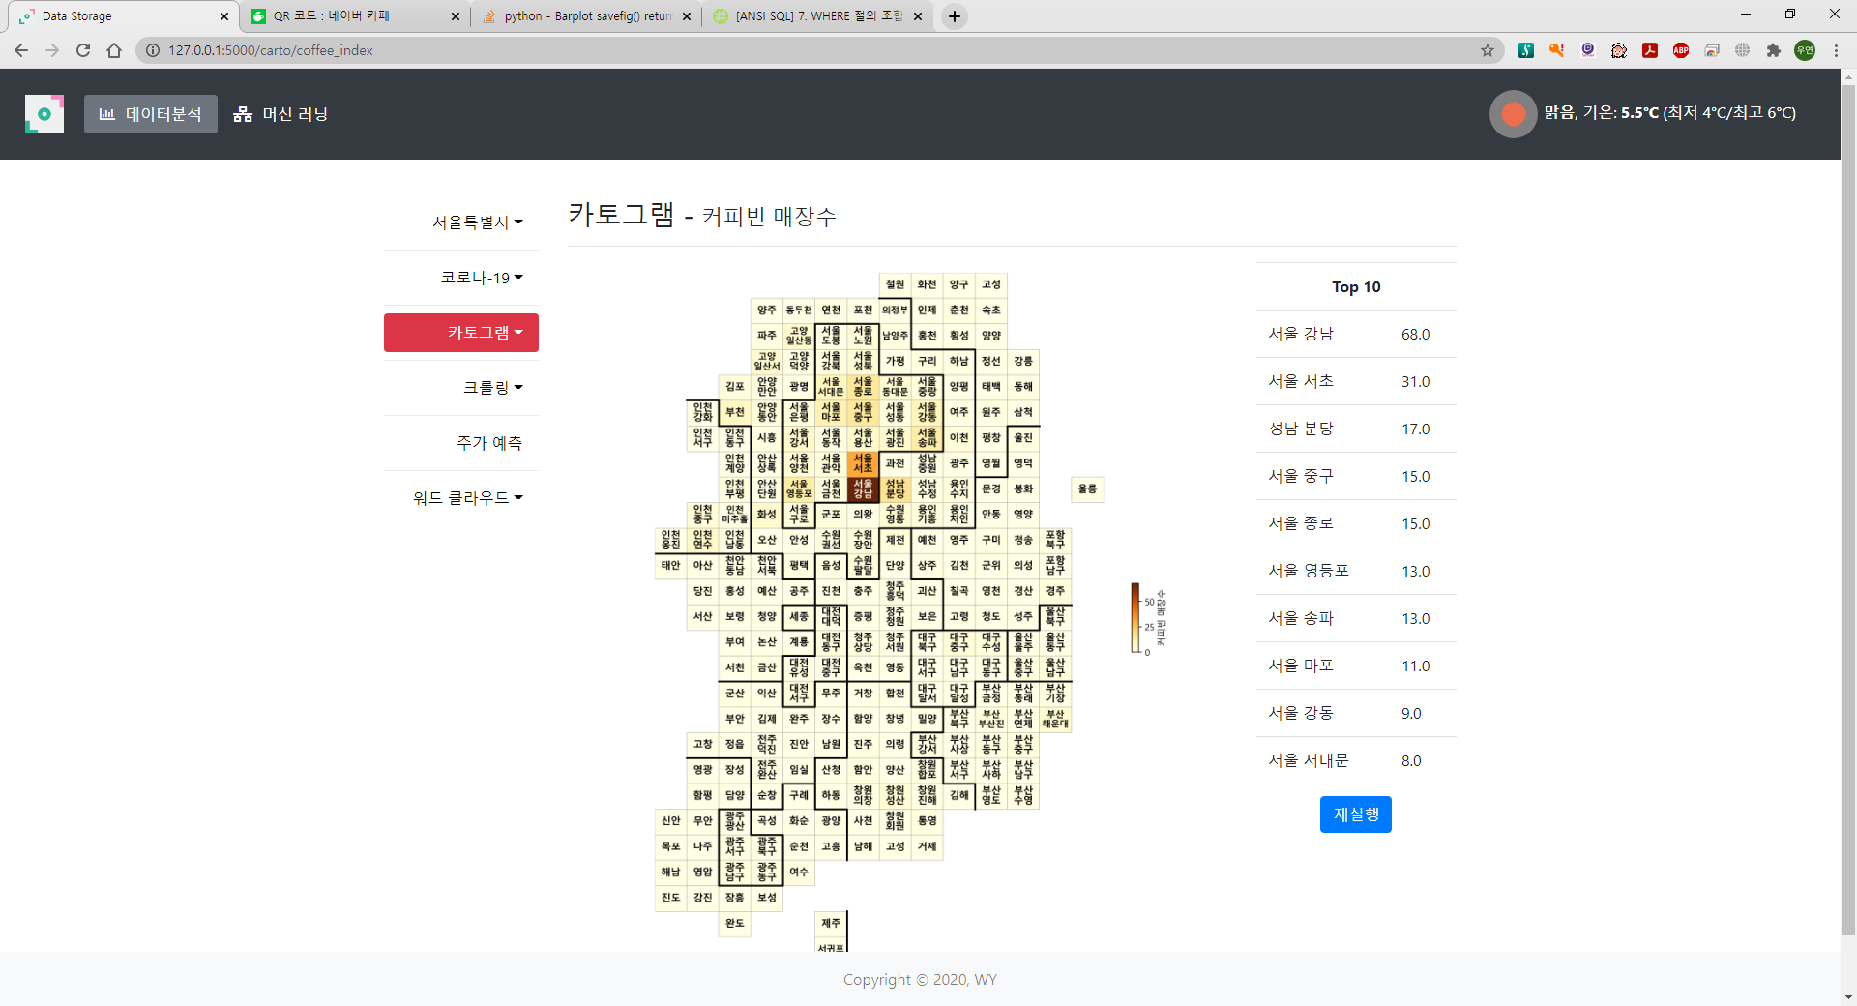
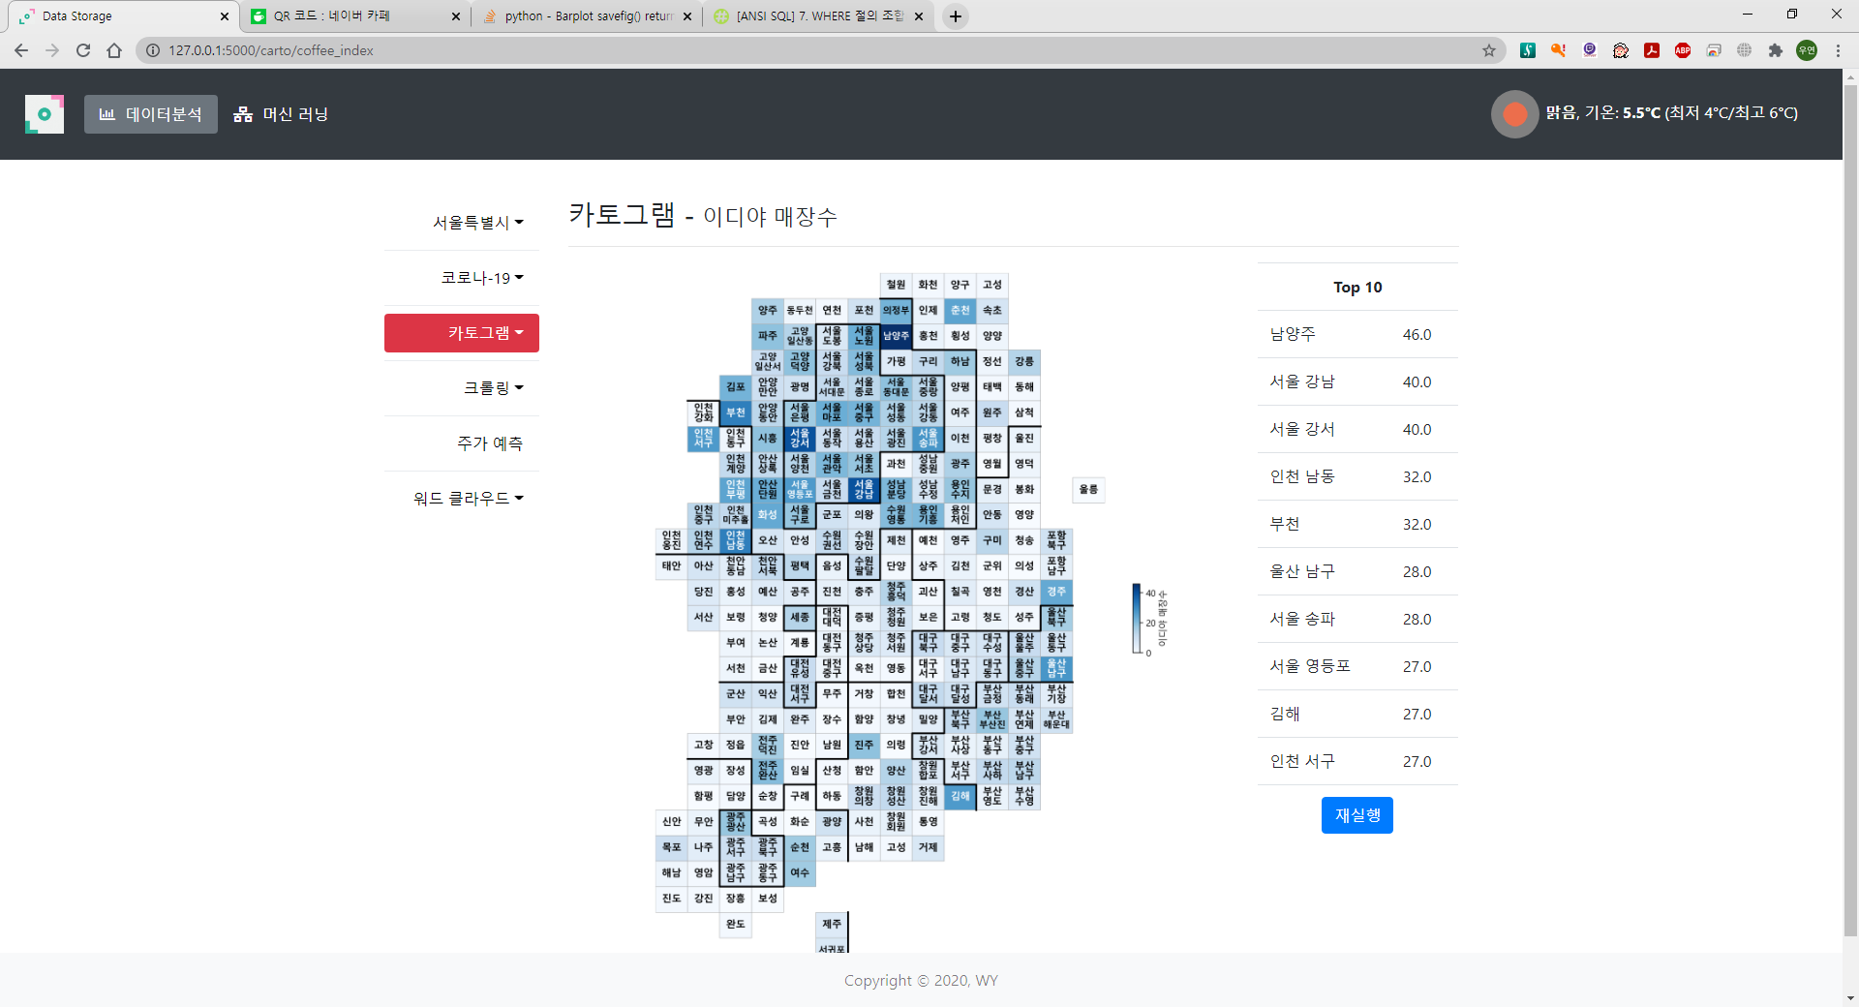
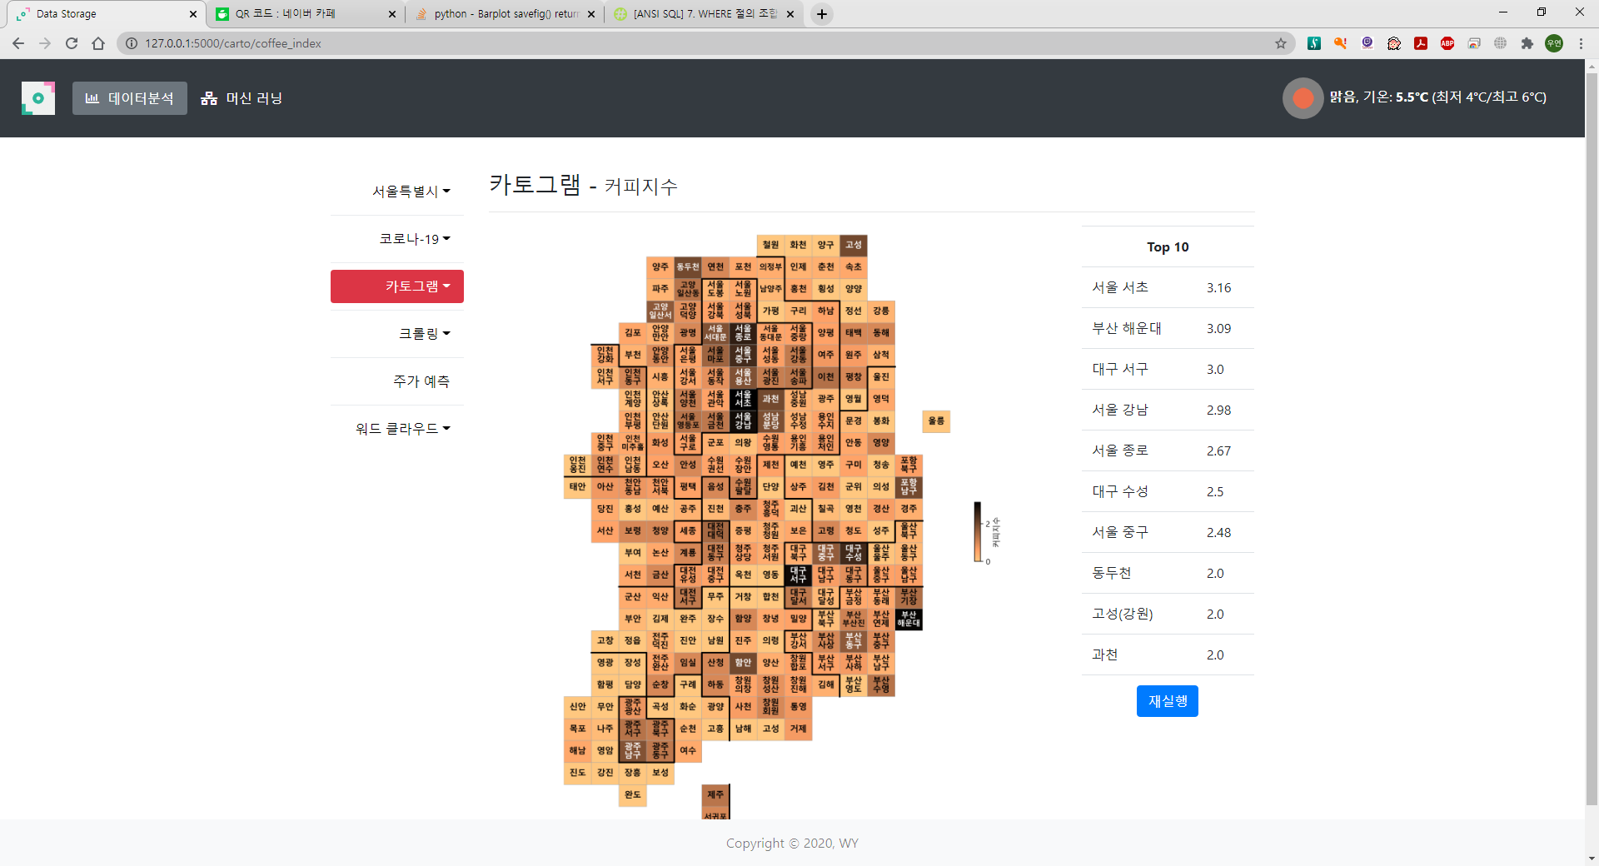
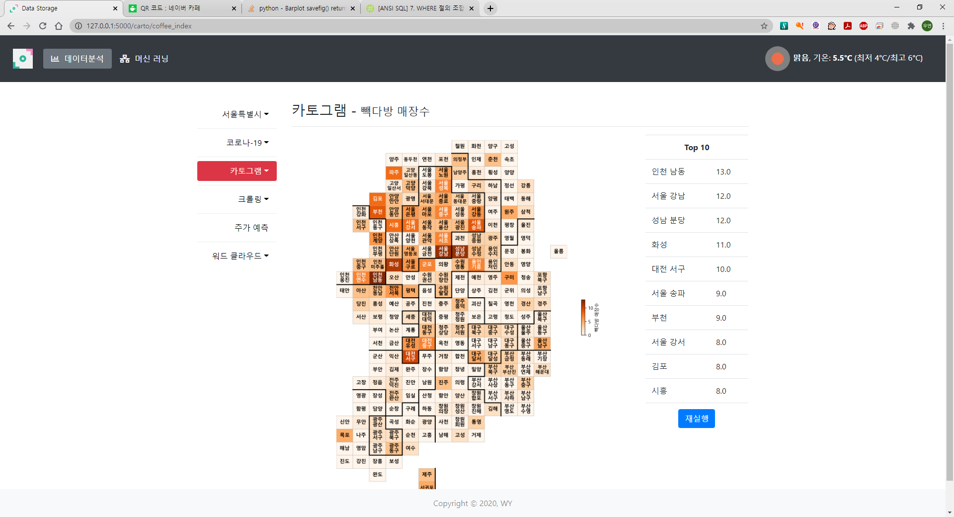
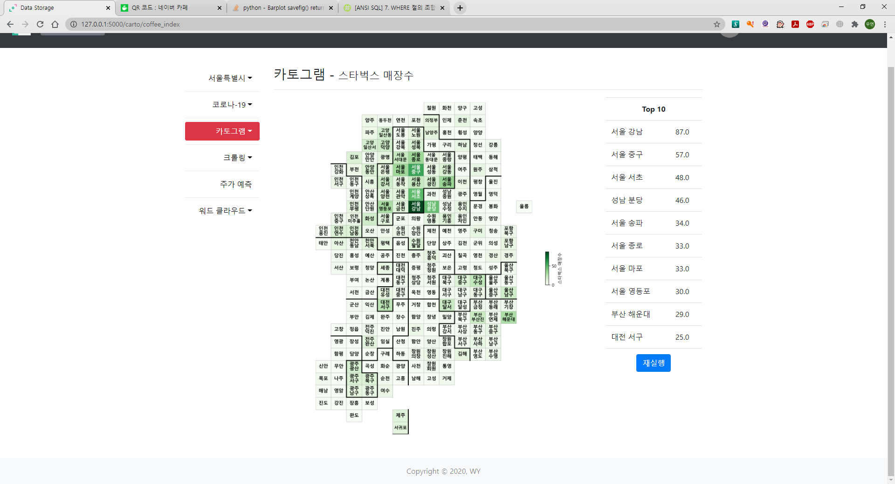

Slide 40
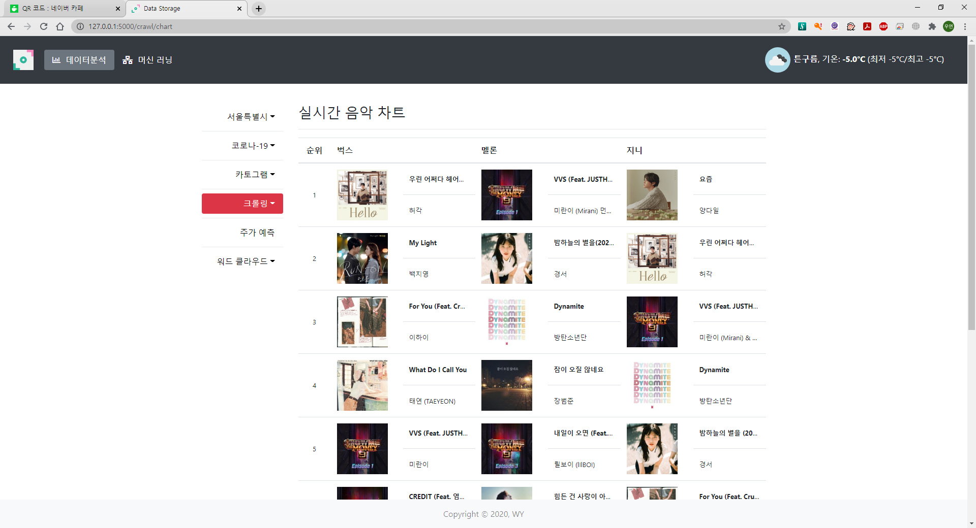
벅스, 멜론, 지니 실시간 차트

Slide 41
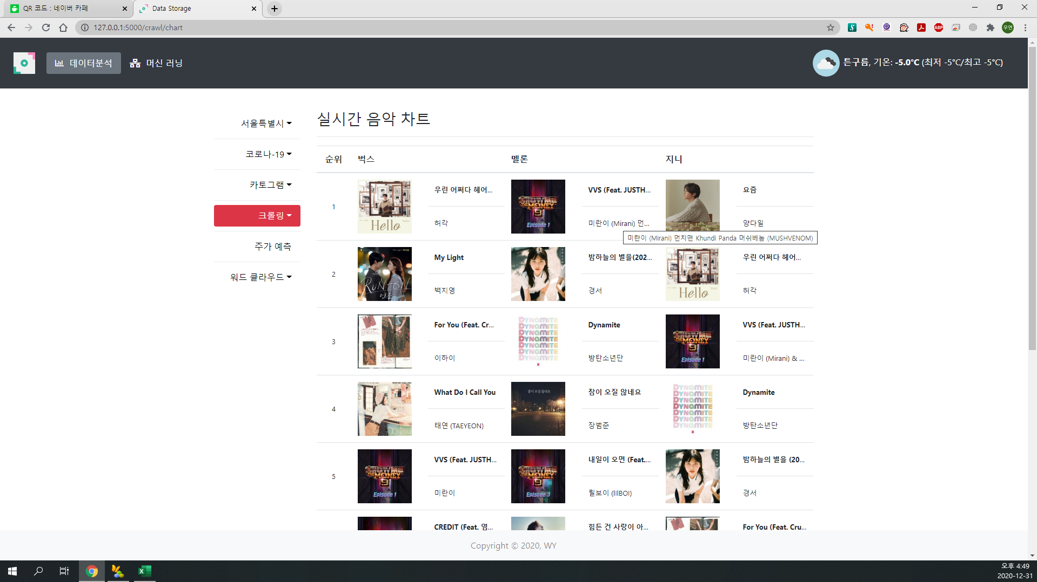
마우스 오버
툴팁

Slide 42
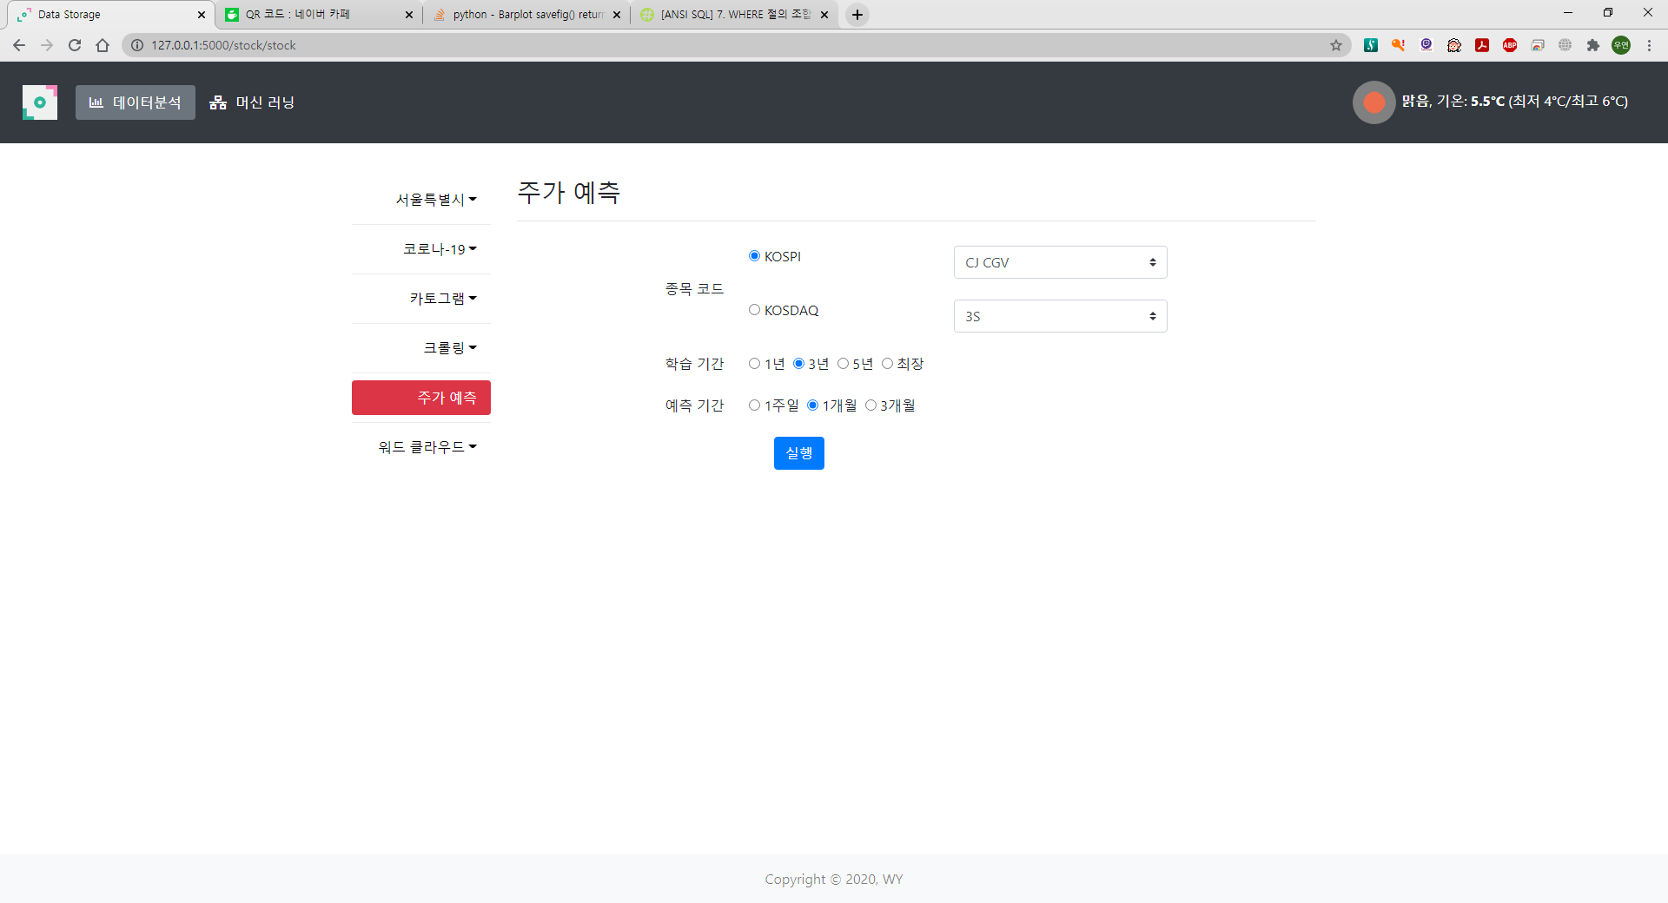

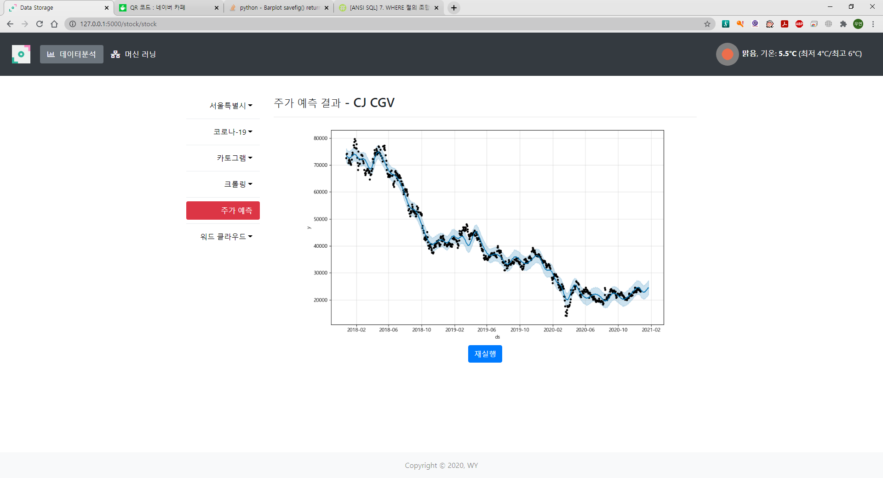
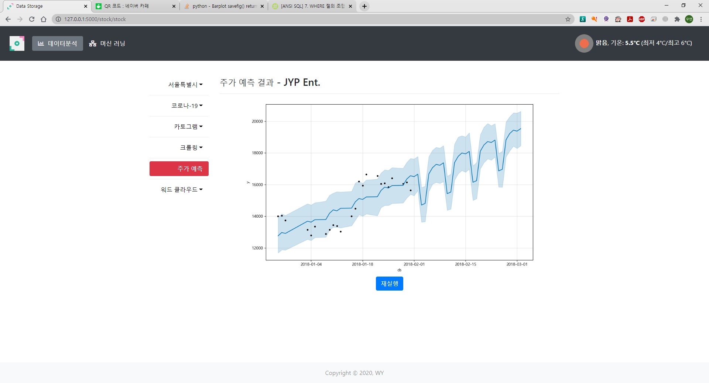

Slide 43
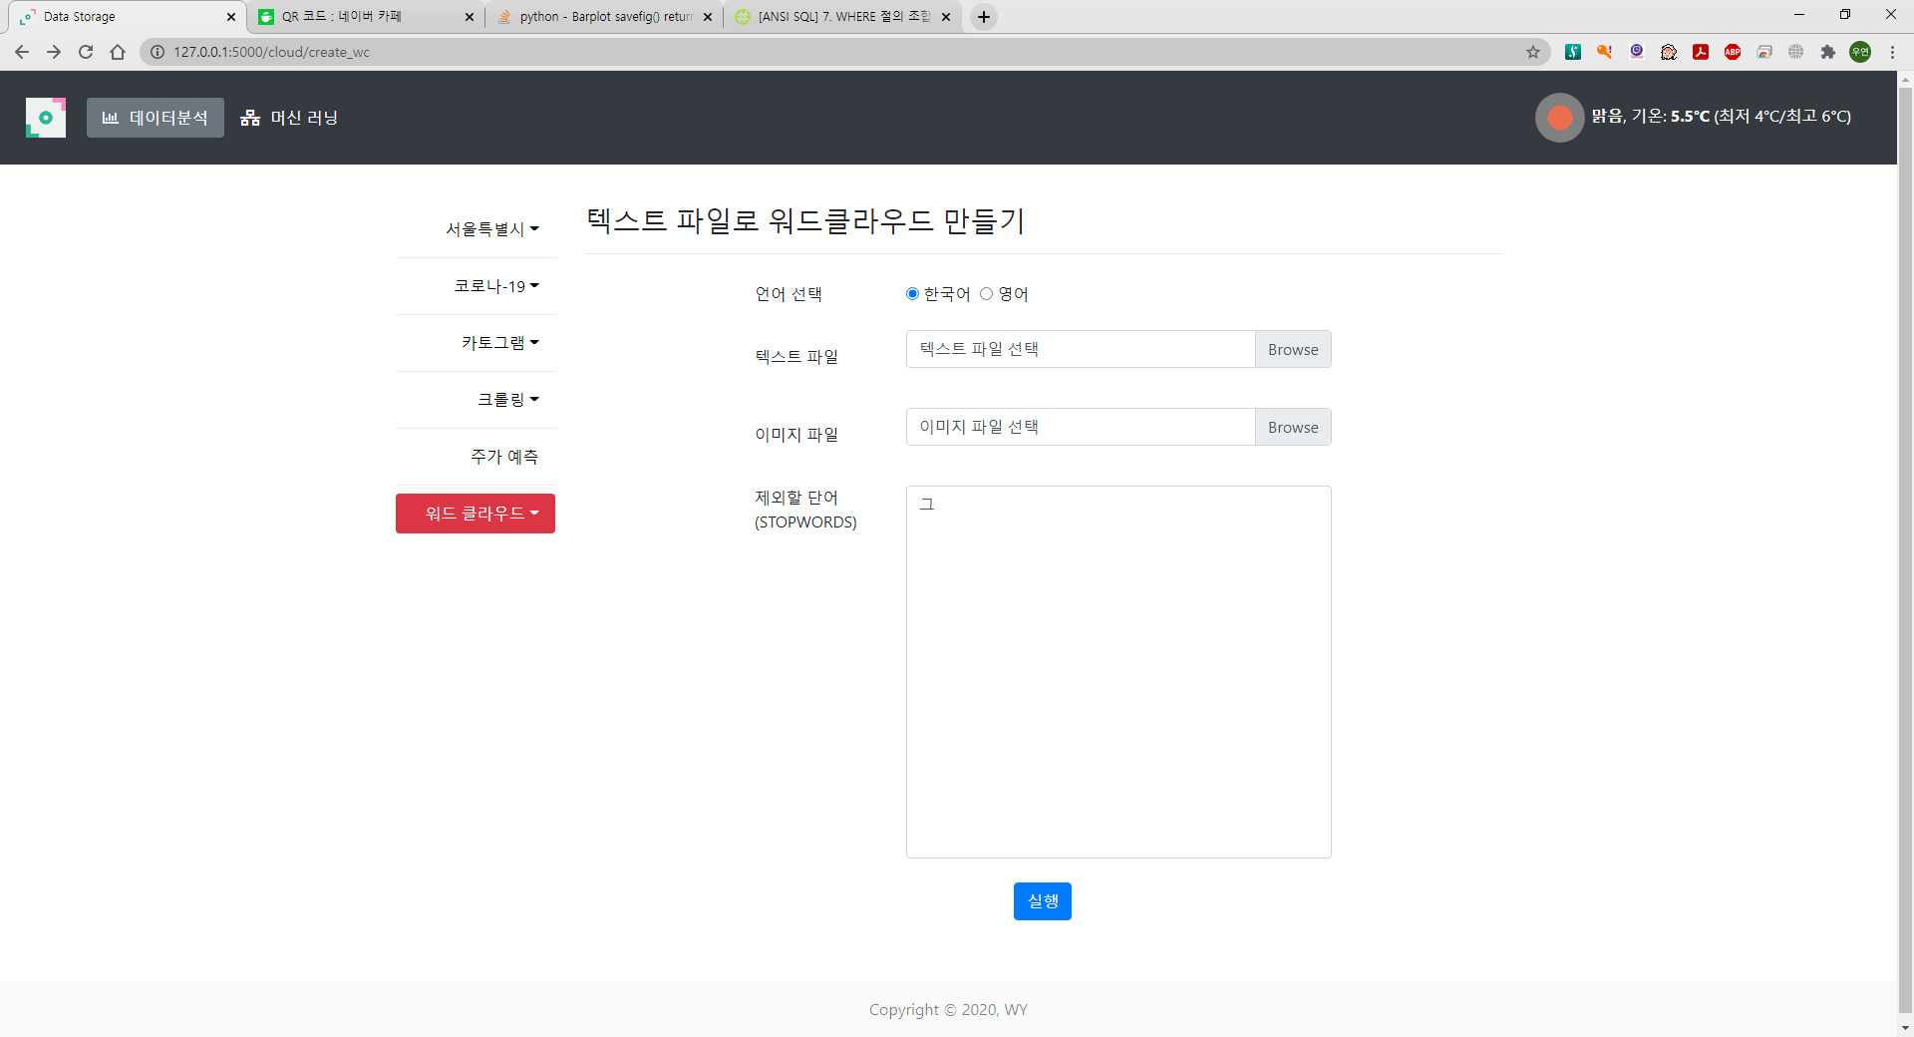

Slide 44
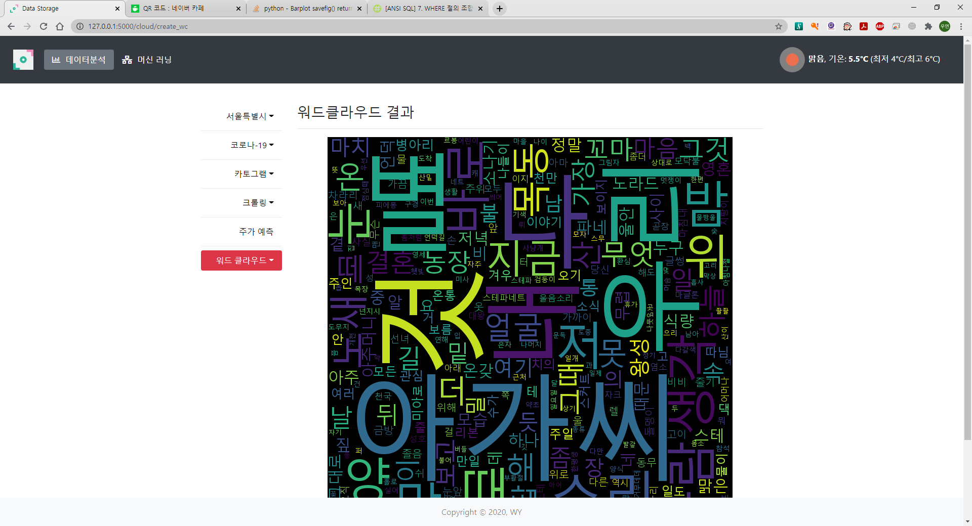

Slide 45


Slide 46
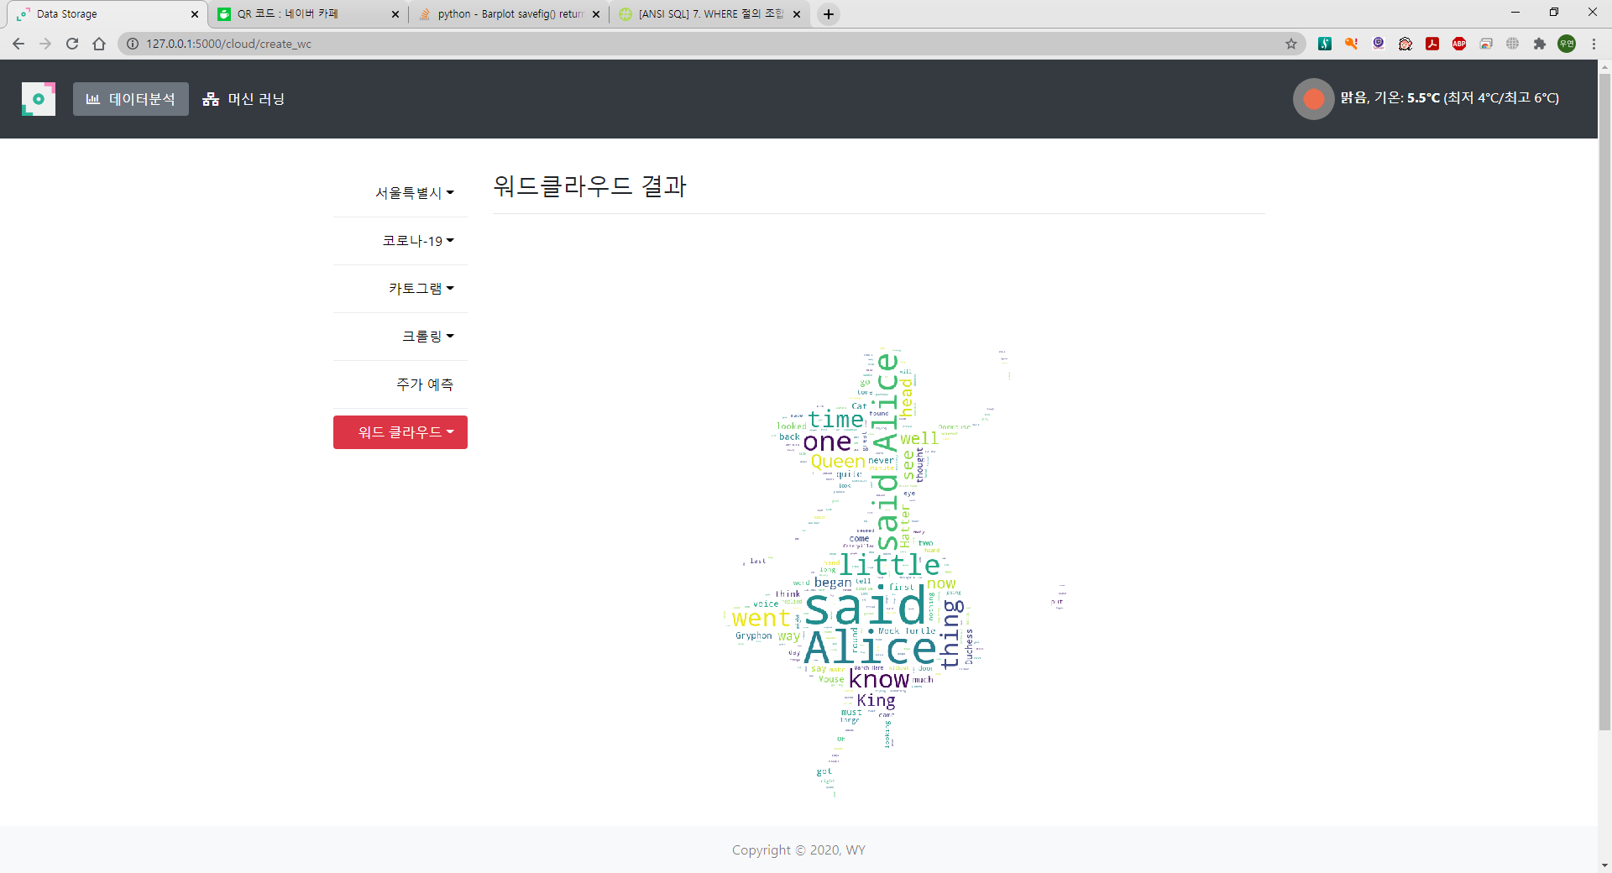

Slide 47
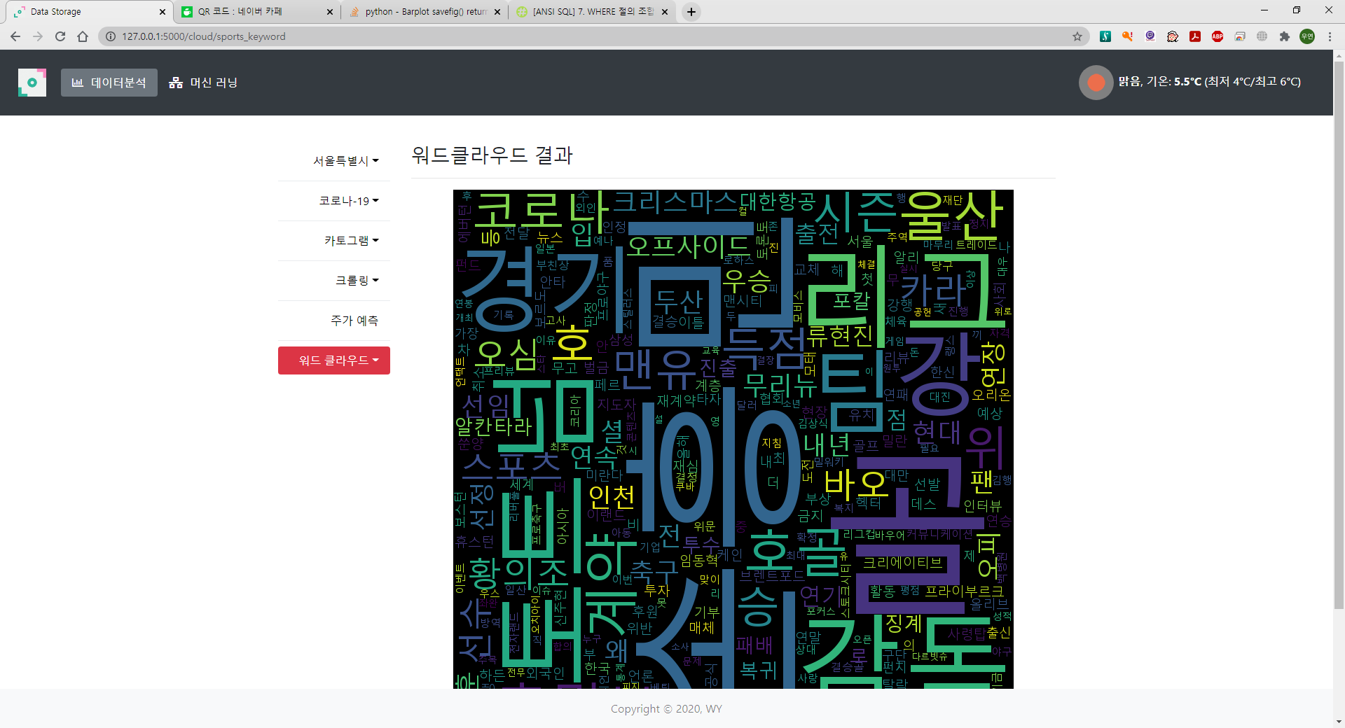
스포츠 뉴스 크롤링 후 워드클라우드

Slide 48
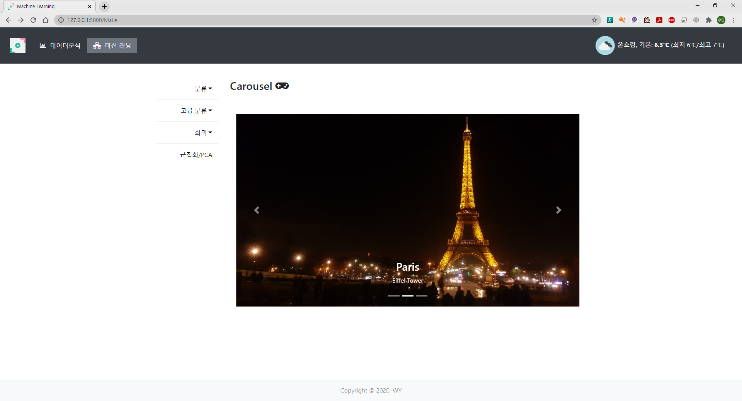
MaLe 화면

Slide 49



Slide 50



Slide 51



Slide 52



Slide 53



Slide 54



Slide 55




Slide 56



Slide 57




Slide 58



Slide 59



Slide 60



Slide 61



Slide 62


Slide 63




영어
일본어
중국어
프랑스어

Slide 64


Slide 65


Slide 66



한 →영
영→ 한

Slide 67


Slide 68


영어 감지
일본어 감지

